Slide 1
Chapter 2 Introduction to Java Applications; Input/Output and Operators
Java How to Program, 11/e, Global Edition
Questions? E-mail paul.deitel@deitel.com

Slide 2
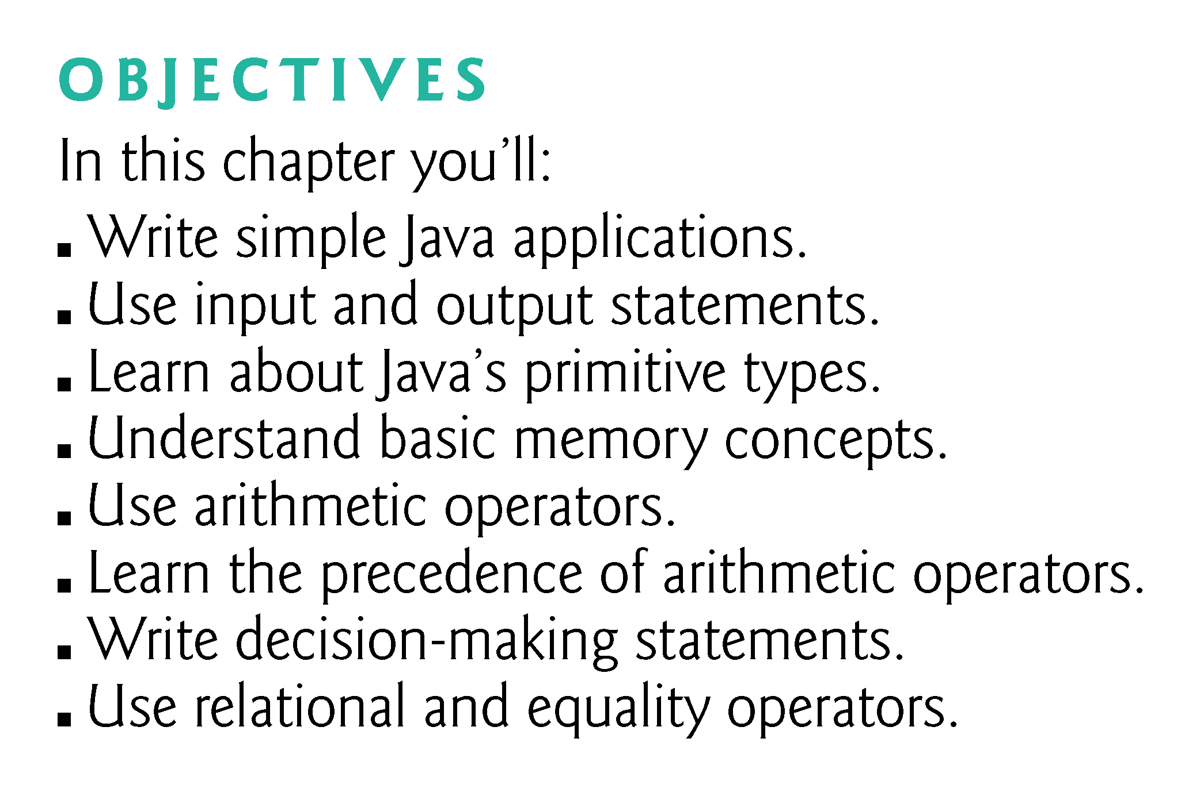

Slide 3
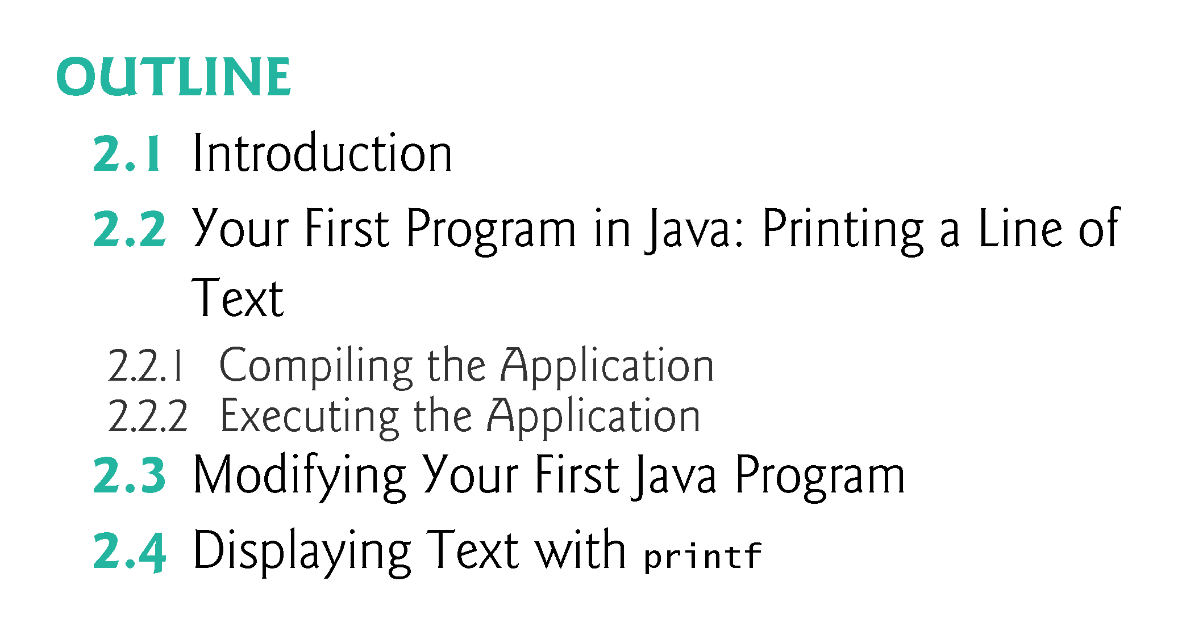

Slide 4
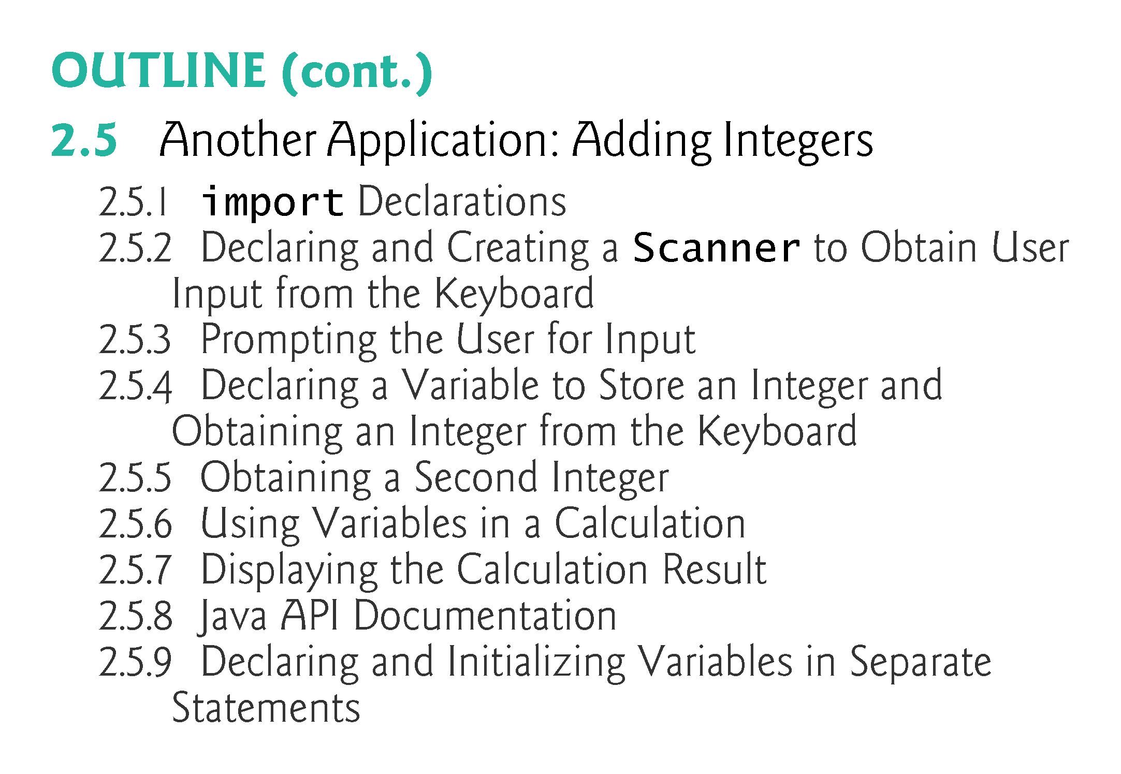

Slide 5
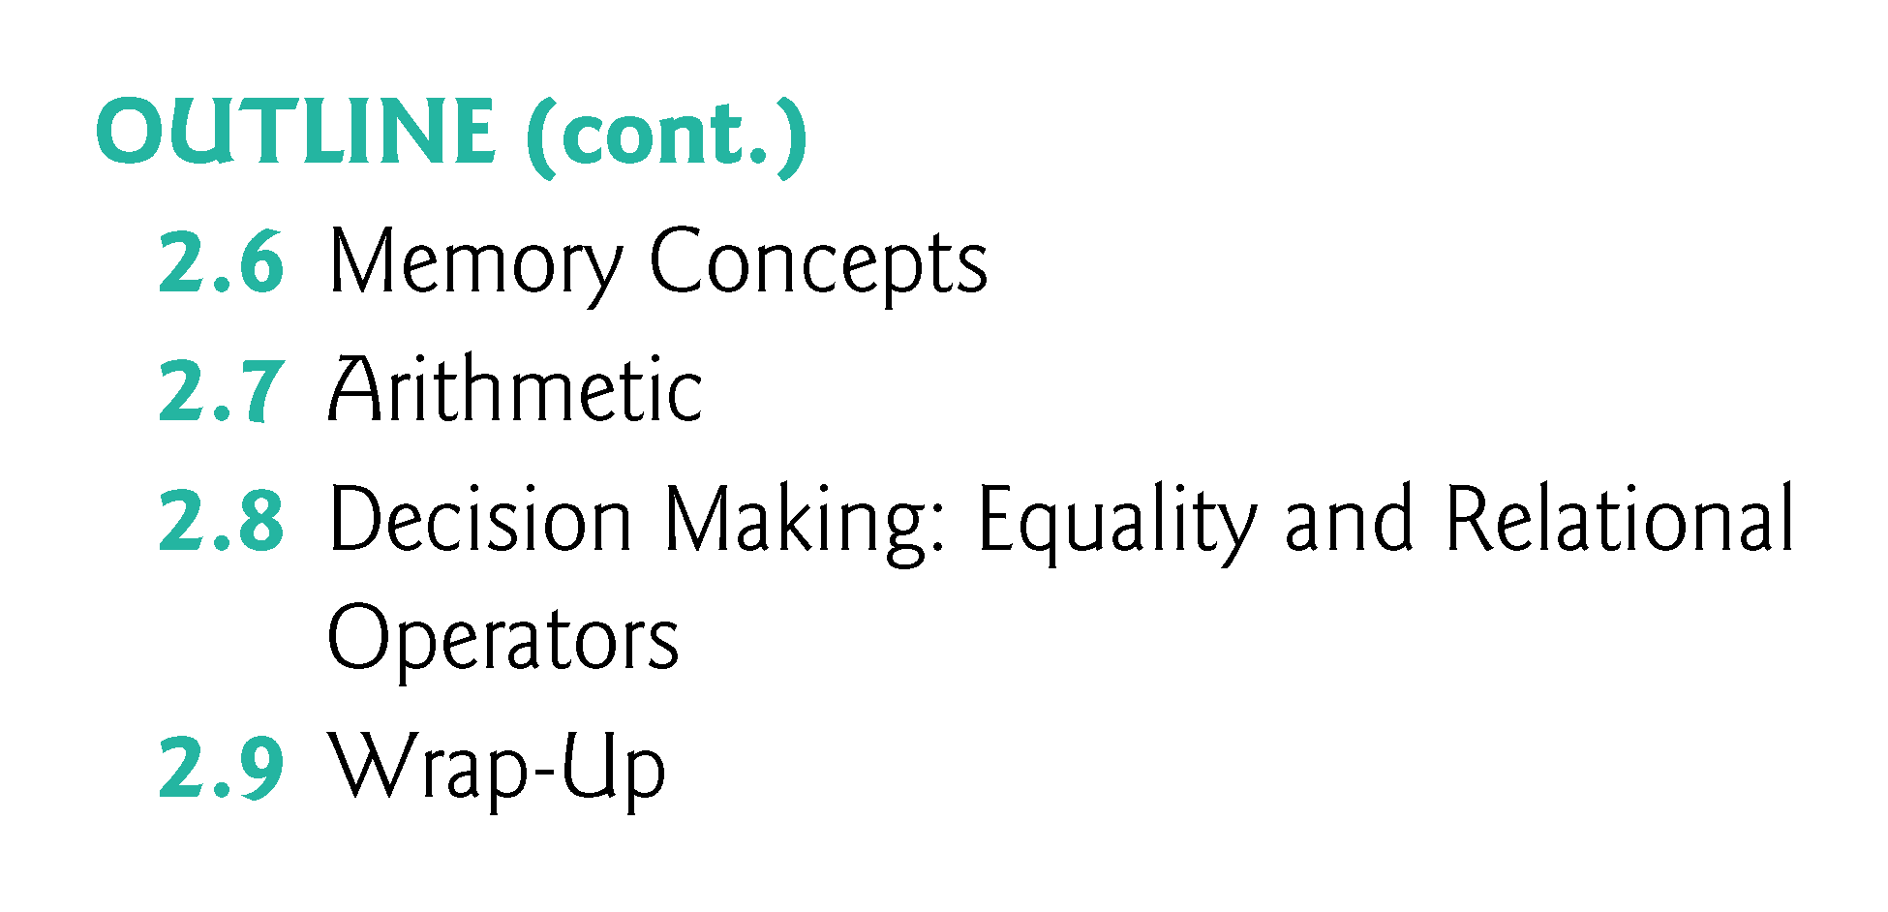

Slide 6
2.1 Introduction
Java application programming
Use tools from the JDK to compile and run programs.

Slide 7
2.2 Your First Program in Java: Printing a Line of Text
Java application
A computer program that executes when you use the java command to launch the Java Virtual Machine (JVM).
Sample program in Fig. 2.1 displays a line of text.

Slide 8
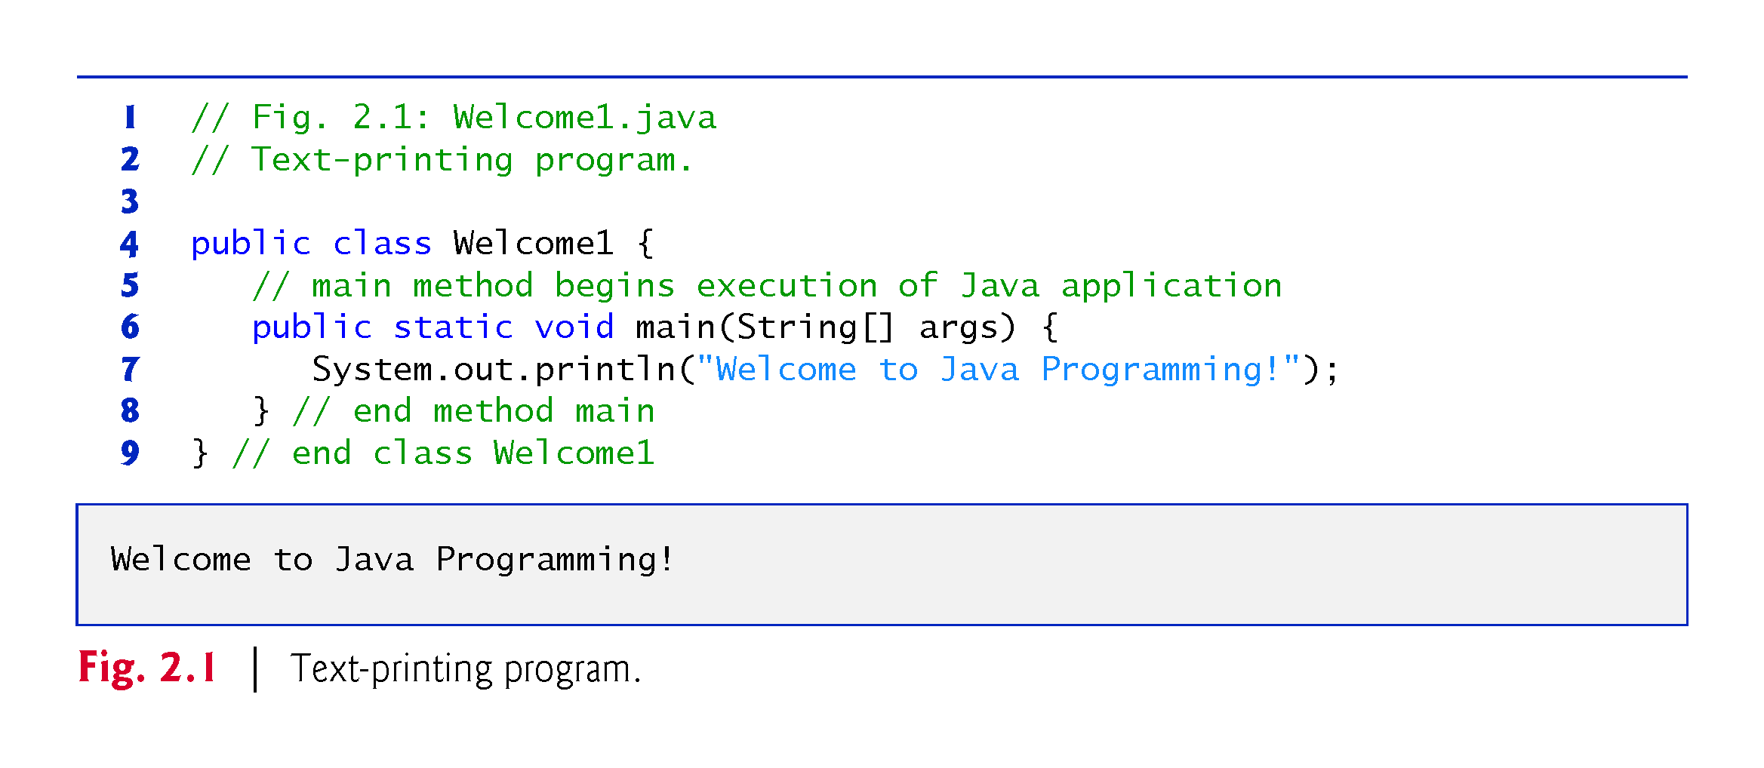

Slide 9
2.2 Your First Program in Java: Printing a Line of Text (Cont.)
Commenting Your Programs
Comments
// Fig. 2.1: Welcome1.java
// indicates that the line is a comment.
Used to document programs and improve their readability.
Compiler ignores comments.
A comment that begins with // is an end-of-line comment—it terminates at the end of the line on which it appears.
Traditional comment, can be spread over several lines as in
/* This is a traditional comment. It can be split over multiple lines */
This type of comment begins with /* and ends with */.
All text between the delimiters is ignored by the compiler.

Slide 10
2.2 Our First Program in Java: Printing a Line of Text (Cont.)
Javadoc comments
Delimited by /** and */.
All text between the Javadoc comment delimiters is ignored by the compiler.
Enable you to embed program documentation directly in your programs.
The javadoc utility program (online Appendix G) reads Javadoc comments and uses them to prepare program documentation in HTML5 format.

Slide 11
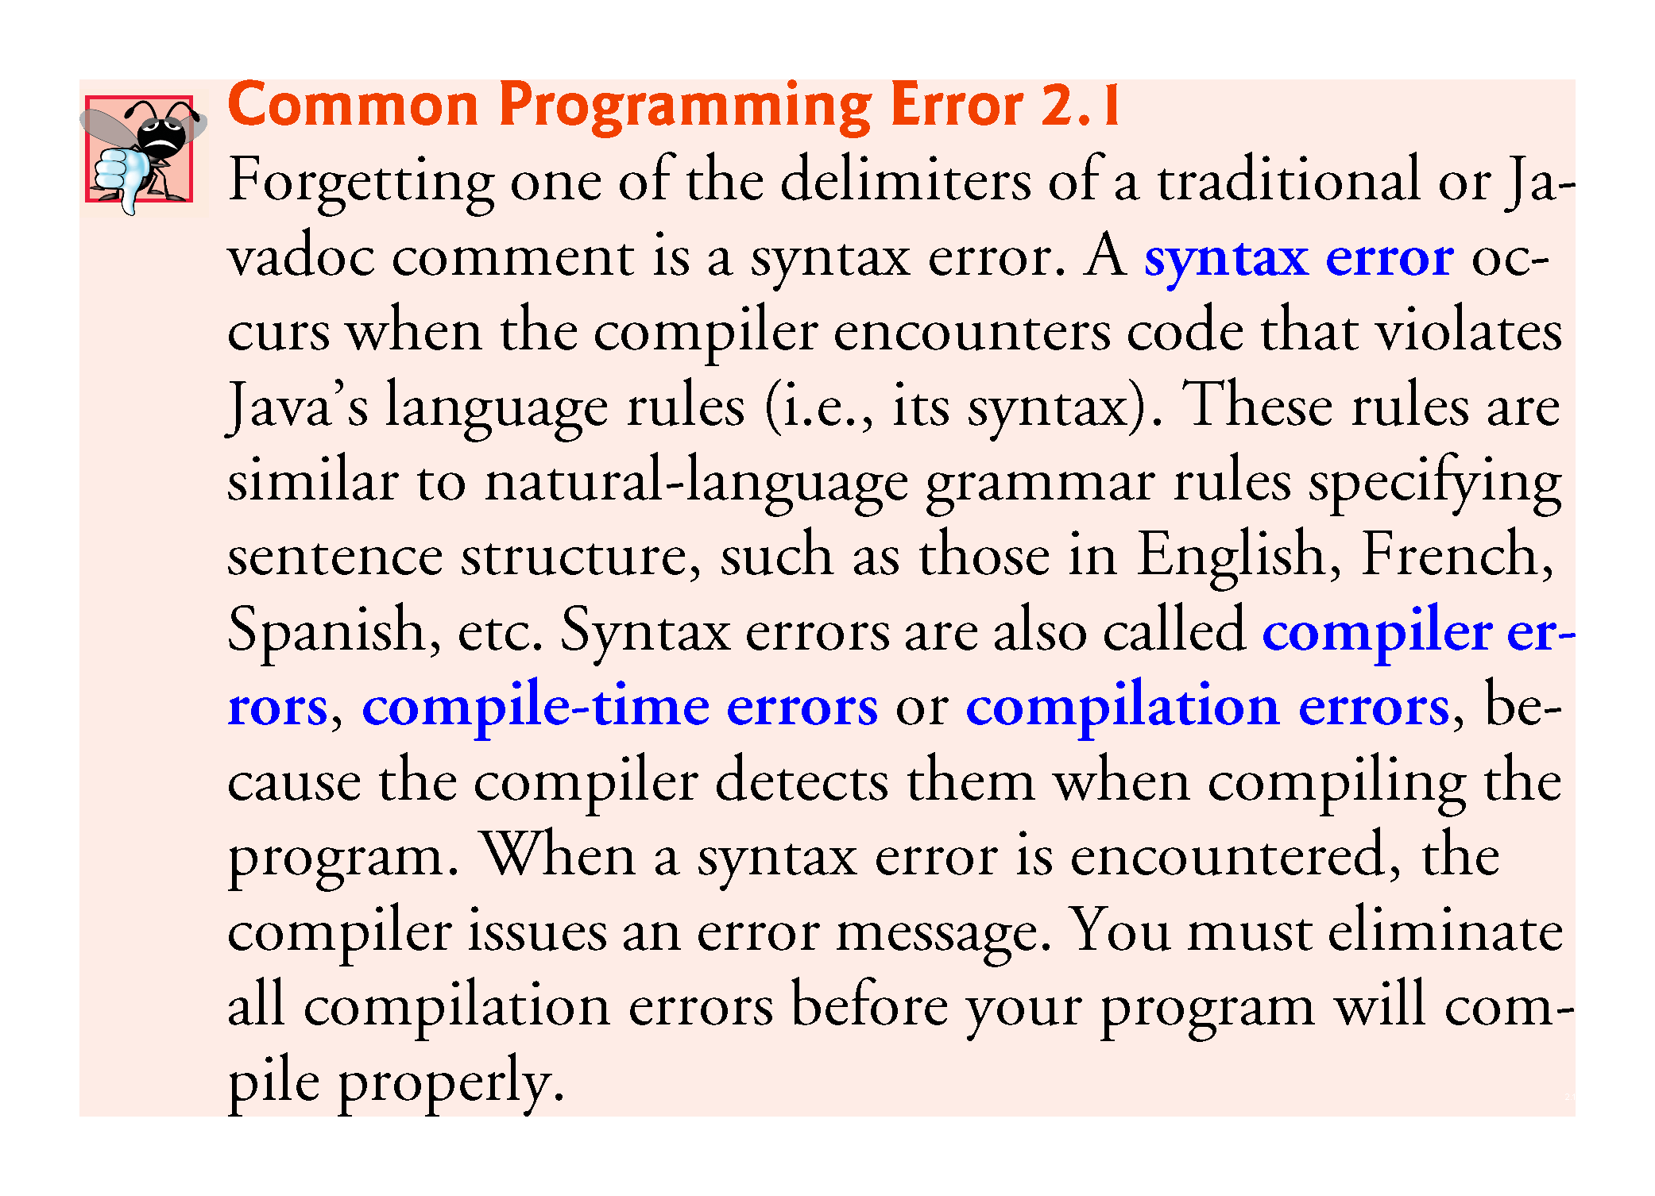

Slide 12
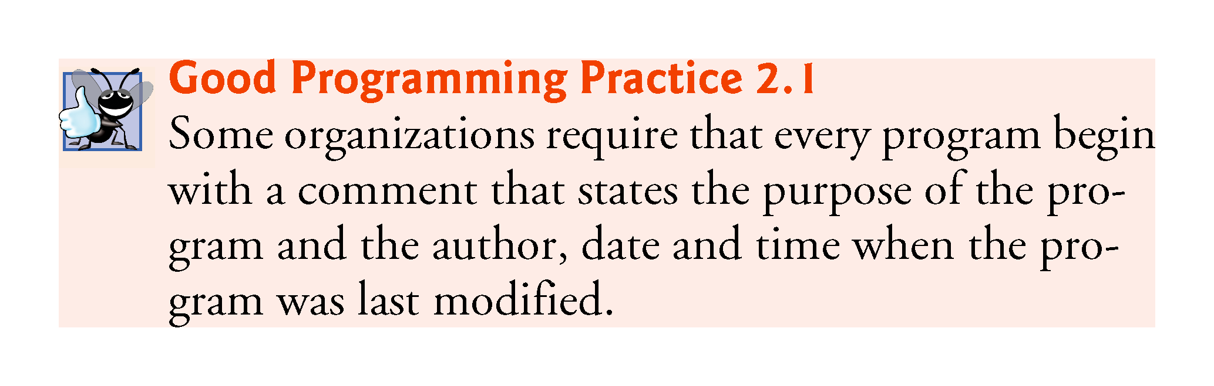

Slide 13
2.2 Your First Program in Java: Printing a Line of Text (Cont.)
Using Blank Lines
Blank lines, space characters and tabs
Make programs easier to read.
Together, they’re known as white space (or whitespace).
White space is ignored by the compiler.

Slide 14


Slide 15
2.2 Your First Program in Java: Printing a Line of Text (Cont.)
Declaring a class
Class declaration
public class Welcome1
Every Java program consists of at least one class that you define.
class keyword introduces a class declaration and is immediately followed by the class name.
Keywords (Appendix C) are reserved for use by Java and are always spelled with all lowercase letters.

Slide 16
2.2 Your First Program in Java: Printing a Line of Text (Cont.)
Filename for a public Class
A public class must be placed in a file that has a filename of the form ClassName.java, so class Welcome1 is stored in the file Welcome1.java.

Slide 17
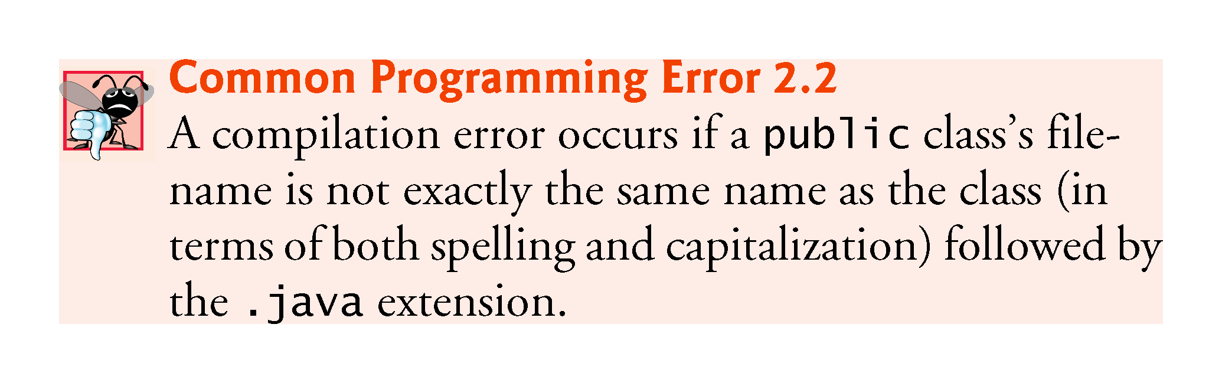

Slide 18
2.2 Your First Program in Java: Printing a Line of Text (Cont.)
Class Names and Identifiers
By convention, begin with a capital letter and capitalize the first letter of each word they include (e.g., SampleClassName).
A class name is an identifier—a series of characters consisting of letters, digits, underscores (_) and dollar signs ($) that does not begin with a digit and does not contain spaces.
Java is case sensitive—uppercase and lowercase letters are distinct—so a1 and A1 are different (but both valid) identifiers.
Underscore (_) in Java 9
As of Java 9, you can no longer use an underscore (_) by itself as an identifier.

Slide 19
2.2 Your First Program in Java: Printing a Line of Text (Cont.)
Class Body
A left brace, {, begins the body of every class declaration.
A corresponding right brace, }, must end each class declaration.

Slide 20
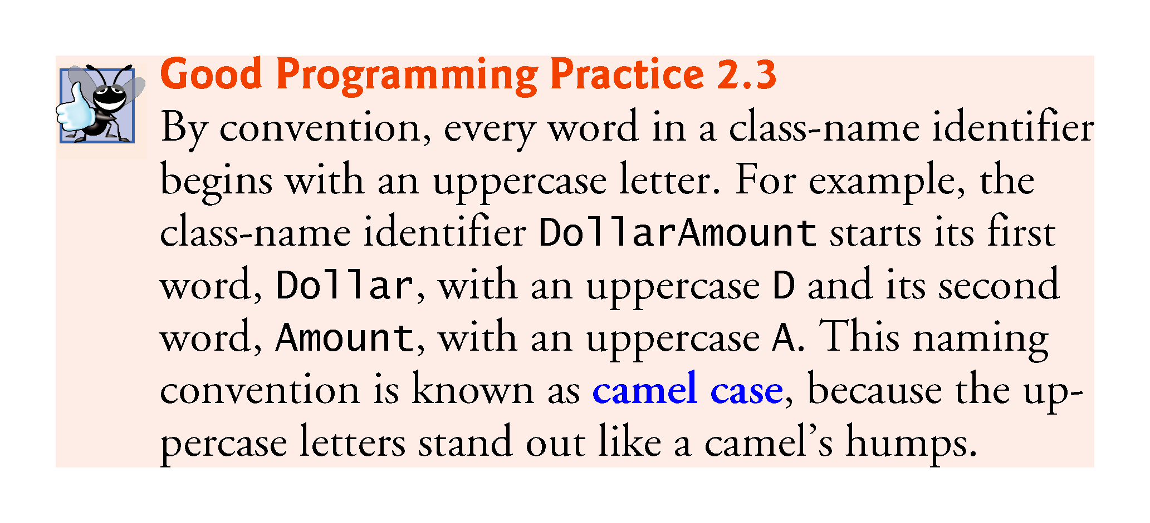

Slide 21
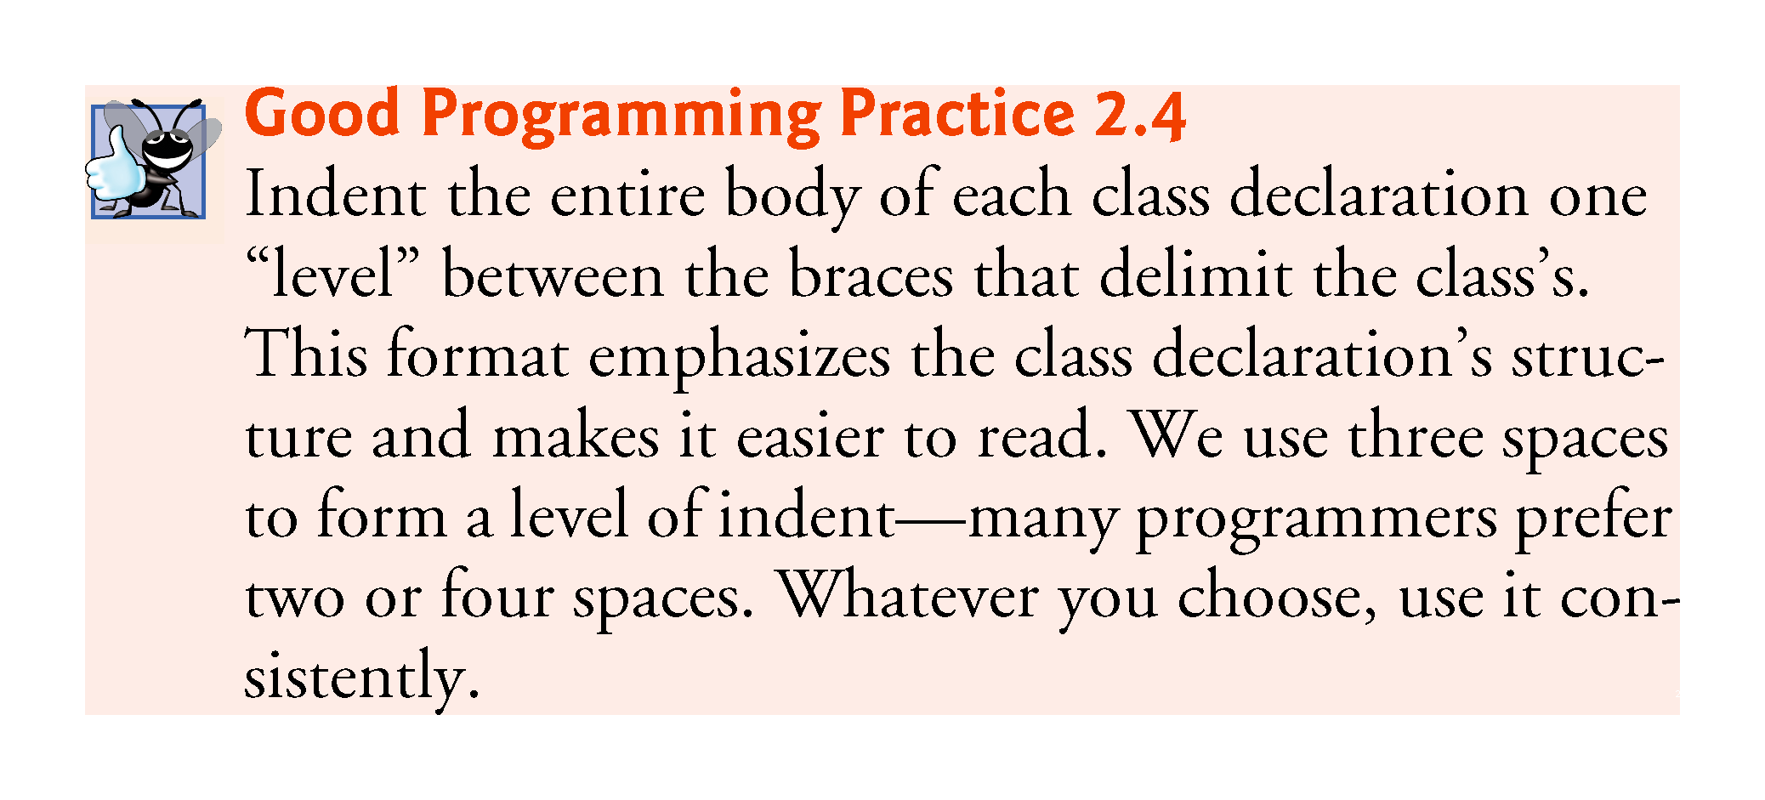

Slide 22
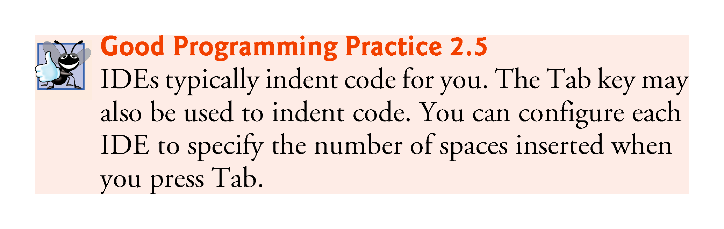

Slide 23
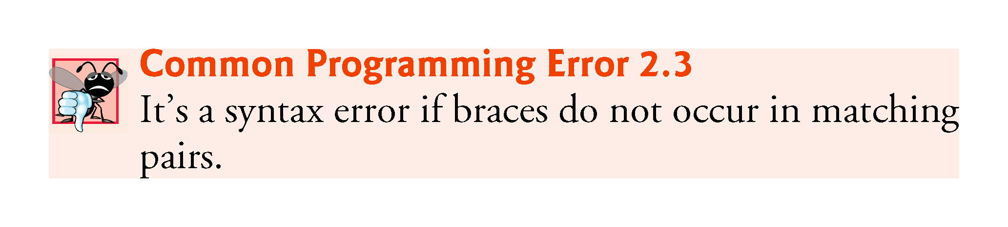

Slide 24
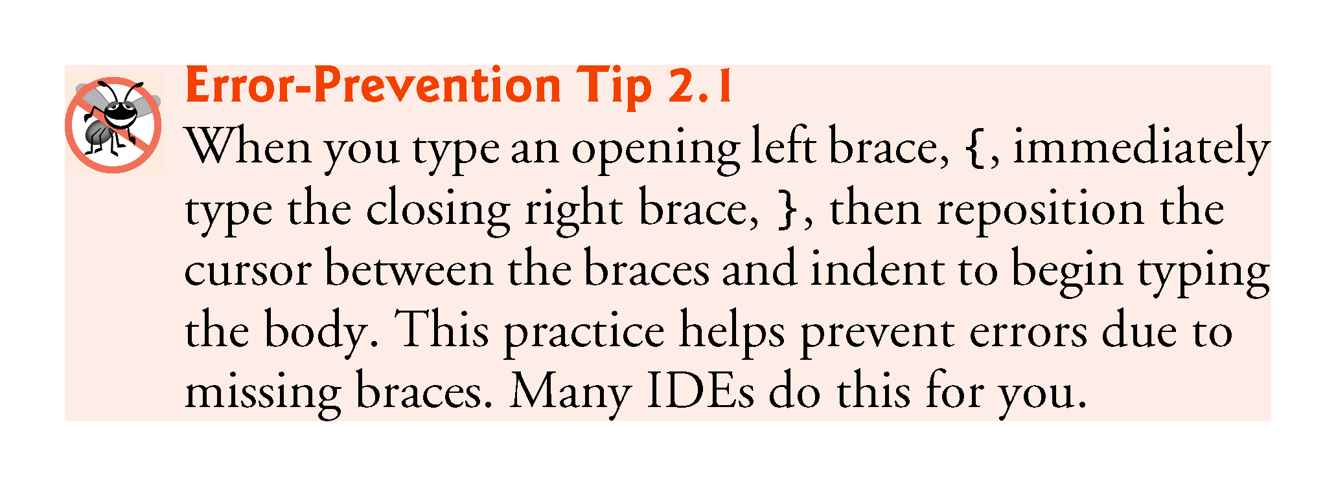

Slide 25
2.2 Your First Program in Java: Printing a Line of Text (Cont.)
Declaring a Method
public static void main(String[] args) {
Starting point of every Java application.
Parentheses after the identifier main indicate that it’s a program building block called a method.
Java class declarations normally contain one or more methods.
main must be defined as shown; otherwise, the JVM will not execute the application.
Methods perform tasks and can return information when they complete their tasks.
Keyword void indicates that this method will not return any information.

Slide 26
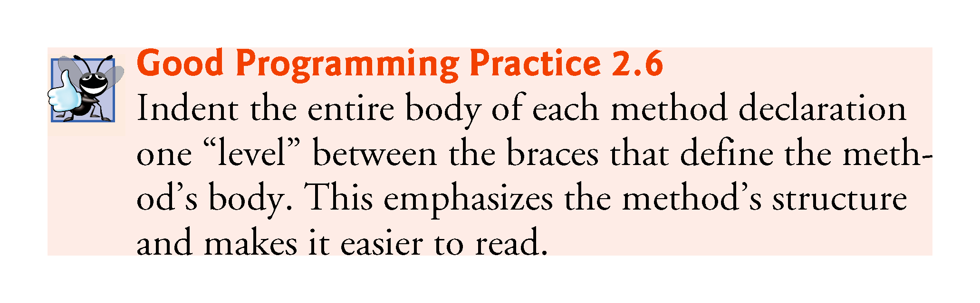

Slide 27
2.2 Your First Program in Java: Printing a Line of Text (Cont.)
Body of the method declaration
Enclosed in left and right braces.
Statement
System.out.println("Welcome to Java Programming!");
Instructs the computer to perform an action
Display the characters contained between the double quotation marks.
Together, the quotation marks and the characters between them are a string—also known as a character string or a string literal.
White-space characters in strings are not ignored by the compiler.
Strings cannot span multiple lines of code.

Slide 28
2.2 Your First Program in Java: Printing a Line of Text (Cont.)
System.out object
Standard output object.
Allows a Java application to display information in the command window from which it executes.
System.out.println method
Displays (or prints) a line of text in the command window.
The string in the parentheses the argument to the method.
Positions the output cursor at the beginning of the next line in the command window.
Most statements end with a semicolon.

Slide 29
2.2 Your First Program in Java: Printing a Line of Text (Cont.)
Compiling Your First Java Application
Open a command window and change to the directory where the program is stored.
Many operating systems use the command cd to change directories.
To compile the program, type
javac Welcome1.java
If the program contains no compilation errors, preceding command creates a.class file (known as the class file) containing the platform-independent Java bytecodes that represent the application.
When we use the java command to execute the application on a given platform, these bytecodes will be translated by the JVM into instructions that are understood by the underlying operating system.

Slide 30
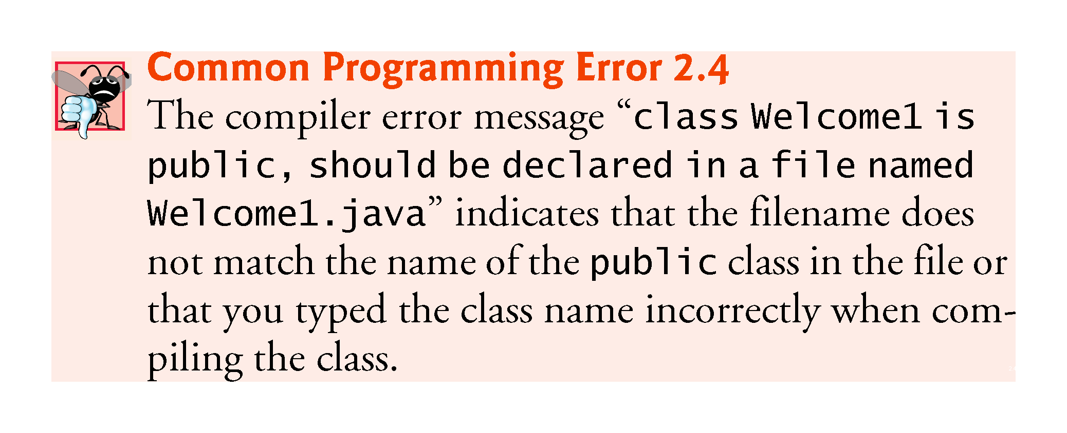

Slide 31
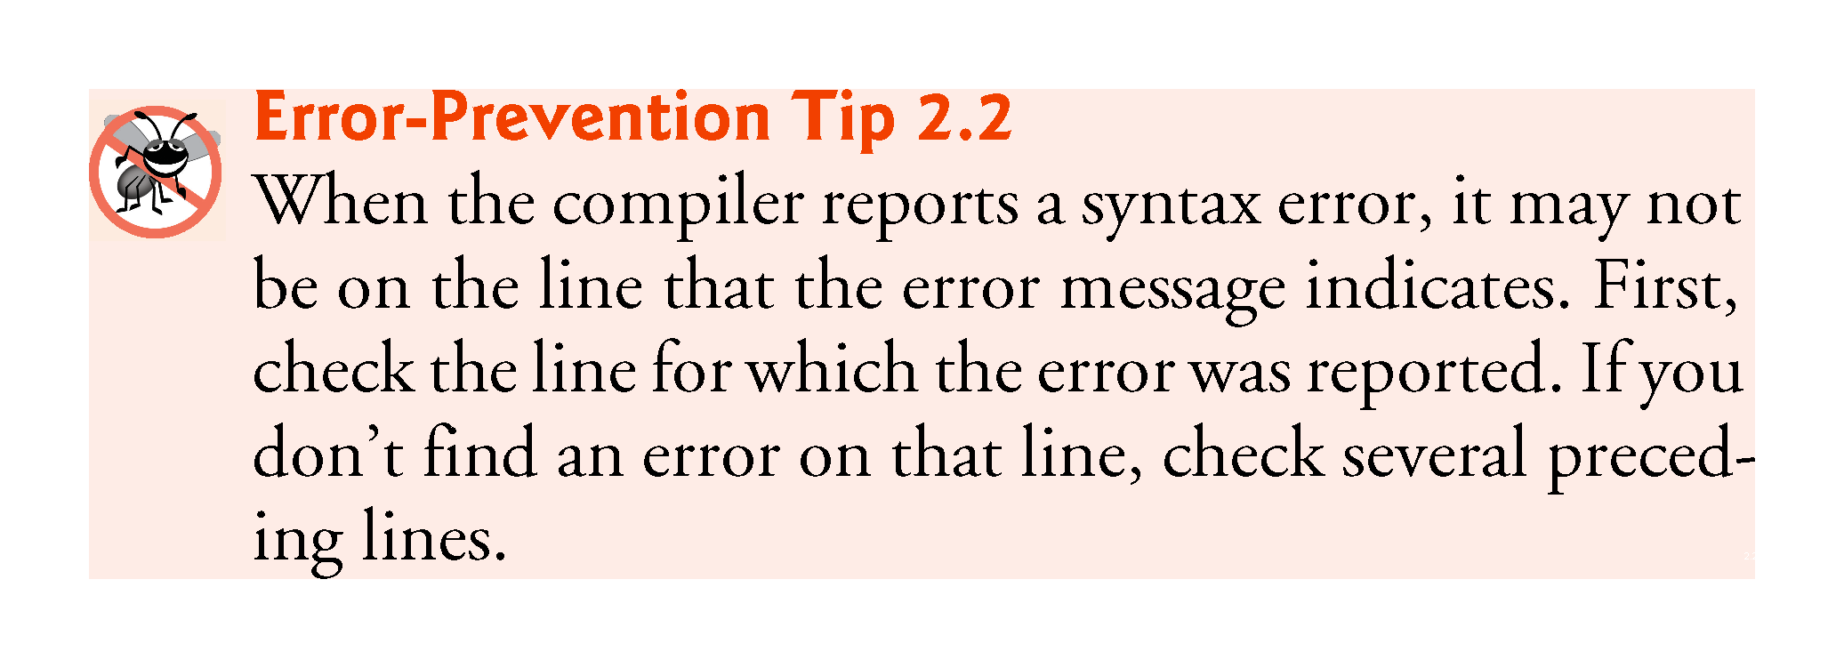

Slide 32
2.2 Your First Program in Java: Printing a Line of Text (Cont.)
Executing the Welcome1 Application
To execute this program in a command window, change to the directory containing Welcome1.java
C:\examples\ch02\fig02_01 on Microsoft Windows or
~/Documents/examples/ch02/fig02_01 on Linux/macOS.
Next, type java Welcome1.
This launches the JVM, which loads the Welcome1.class file.
The command omits the .class file-name extension; otherwise, the JVM will not execute the program.
The JVM calls class Welcome1’s main method.

Slide 33
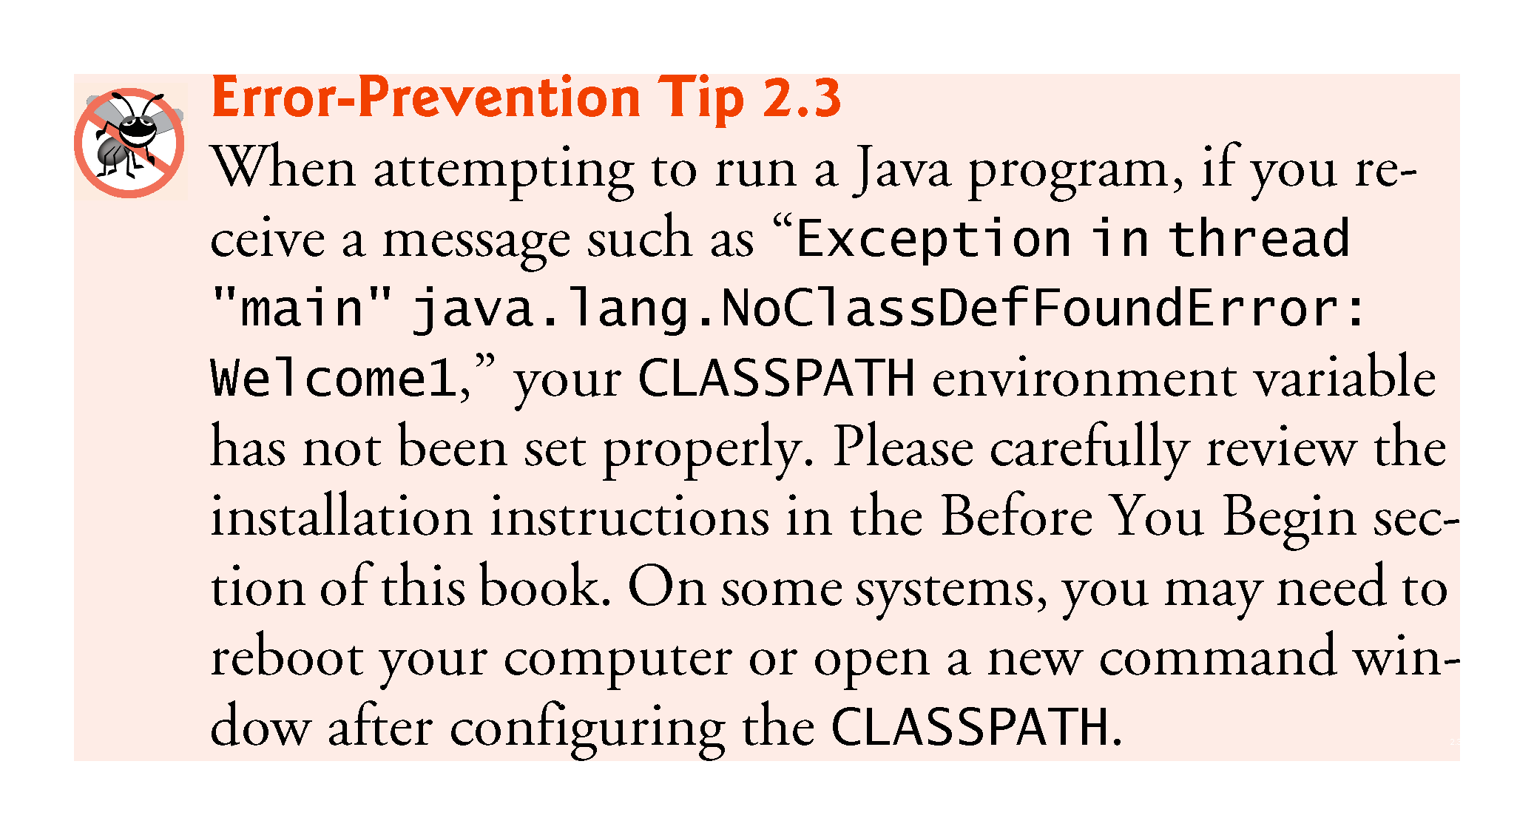

Slide 34
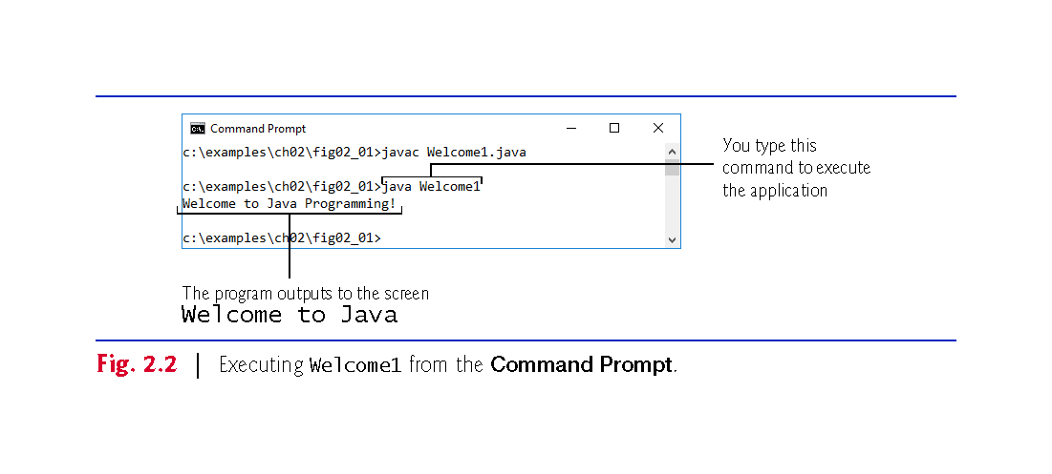

Slide 35
2.3 Modifying Your First Java Program
Class Welcome2, shown in Fig. 2.3, uses two statements to produce the same output as that shown in Fig. 2.1.
New and key features in each code listing are highlighted.
System.out’s method print displays a string.
Unlike println, print does not position the output cursor at the beginning of the next line in the command window.
The next character the program displays will appear immediately after the last character that print displays.

Slide 36
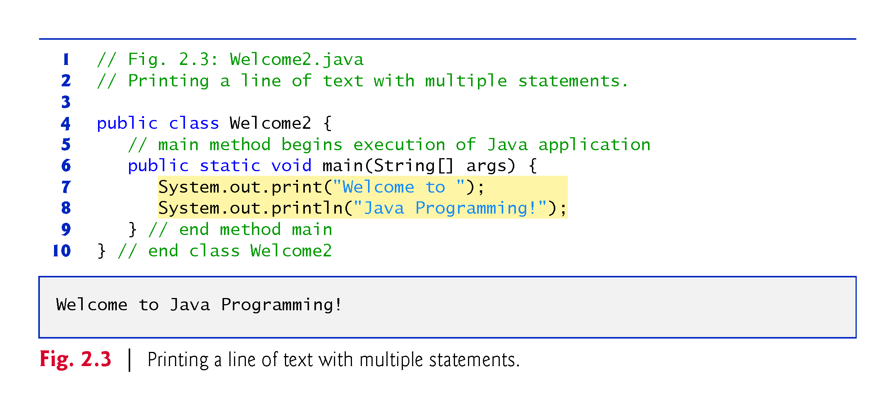

Slide 37
2.3 Modifying Your First Java Program (Cont.)
Newline characters indicate to System.out’s print and println methods when to position the output cursor at the beginning of the next line in the command window.
Newline characters are whitespace characters.
The backslash (\) is called an escape character.
Indicates a “special character”
Backslash is combined with the next character to form an escape sequence—\n represents the newline character.
Complete list of escape sequences
http://docs.oracle.com/javase/specs/jls/se7/html/
jls-3.html#jls-3.10.6.

Slide 38
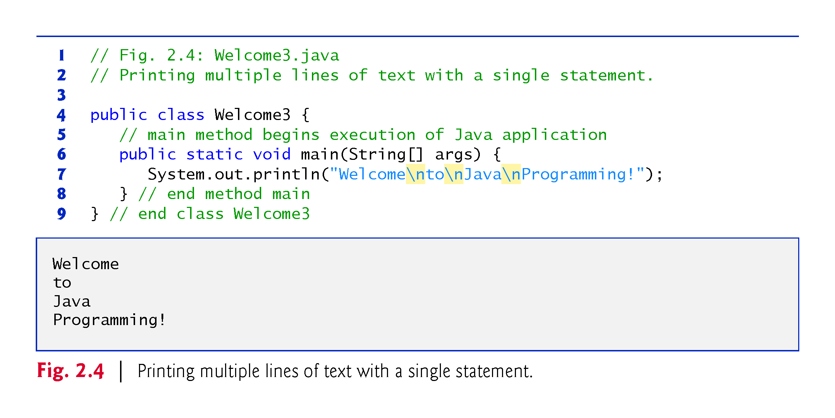

Slide 39
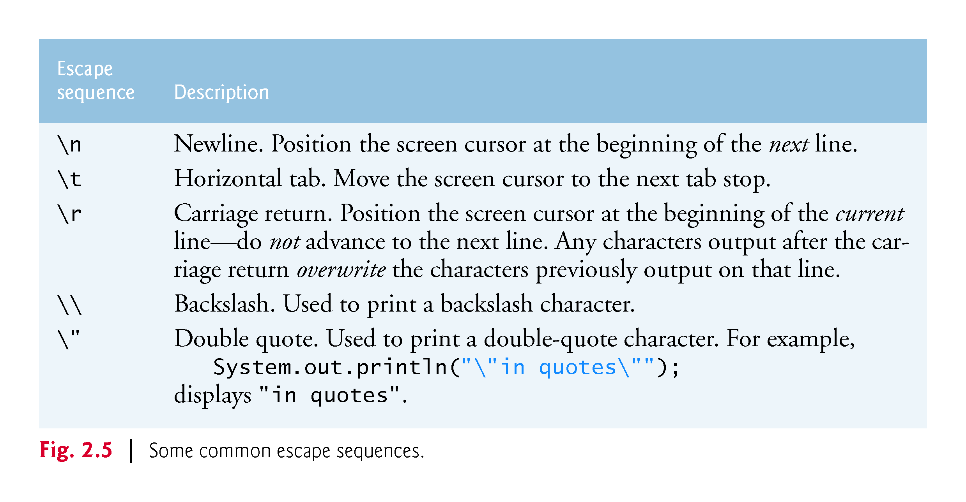

Slide 40
2.4 Displaying Text with printf
System.out.printf method
f means “formatted”
displays formatted data
Multiple method arguments are placed in a comma-separated list.
Calling a method is also referred to as invoking a method.
Java allows large statements to be split over many lines.
Cannot split a statement in the middle of an identifier or string.
Method printf’s first argument is a format string
May consist of fixed text and format specifiers.
Fixed text is output as it would be by print or println.
Each format specifier is a placeholder for a value and specifies the type of data to output.
Format specifiers begin with a percent sign (%) and are followed by a character that represents the data type.
Format specifier %s is a placeholder for a string.

Slide 41
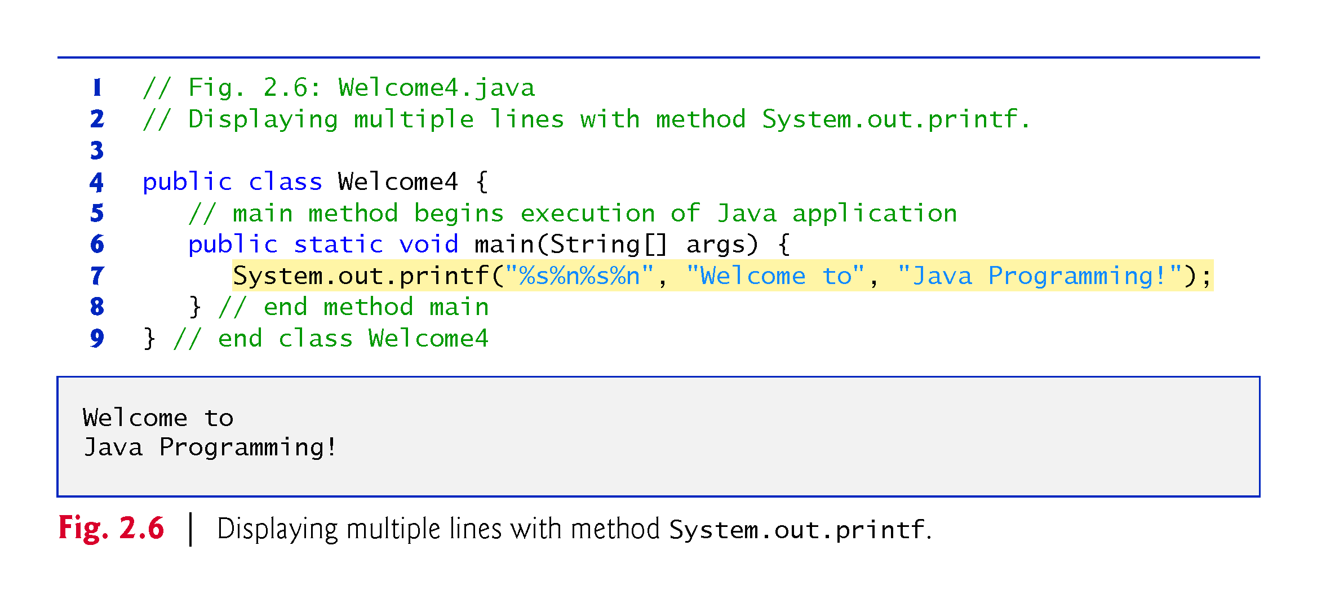

Slide 42
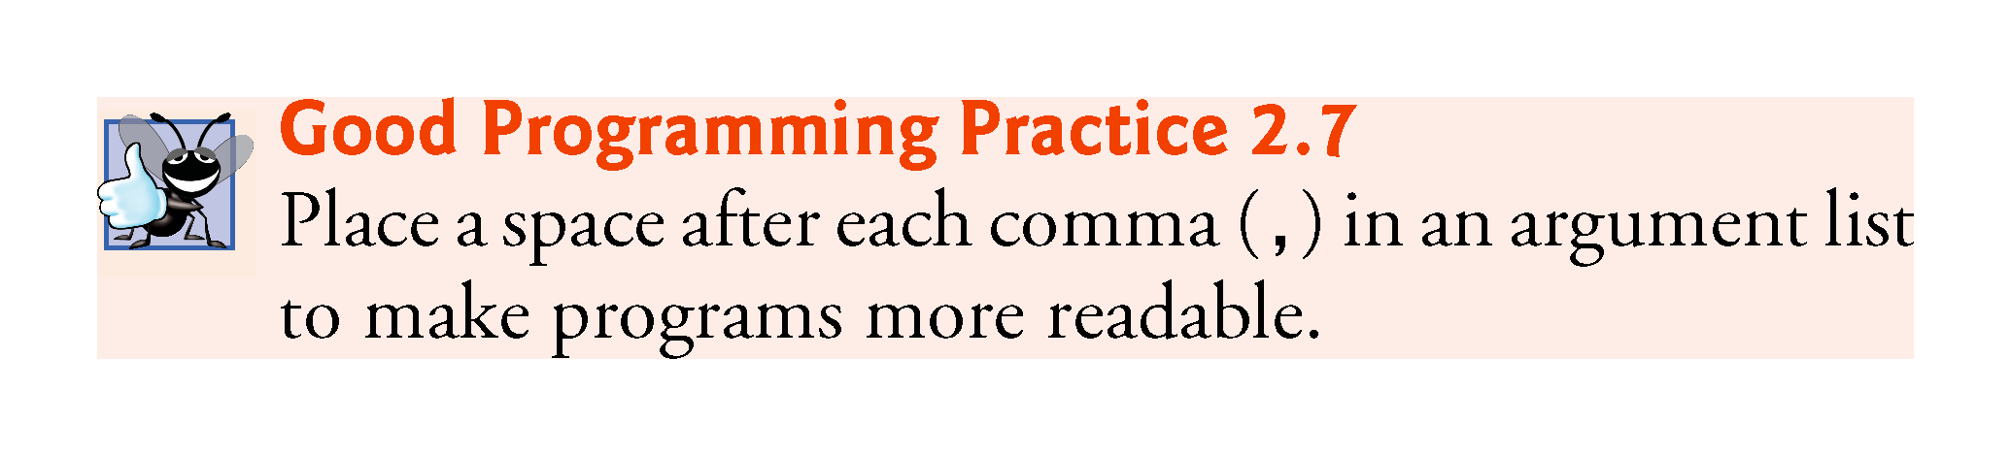

Slide 43
2.5 Another Application: Adding Integers
Integers
Whole numbers, like –22, 7, 0 and 1024)
Programs remember numbers and other data in the computer’s memory and access that data through program elements called variables.
The program of Fig. 2.7 demonstrates these concepts.

Slide 44
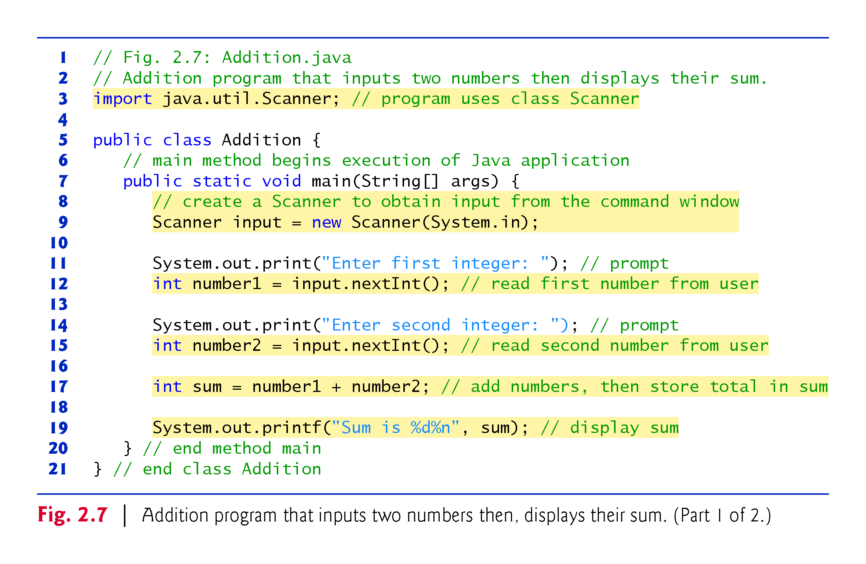

Slide 45
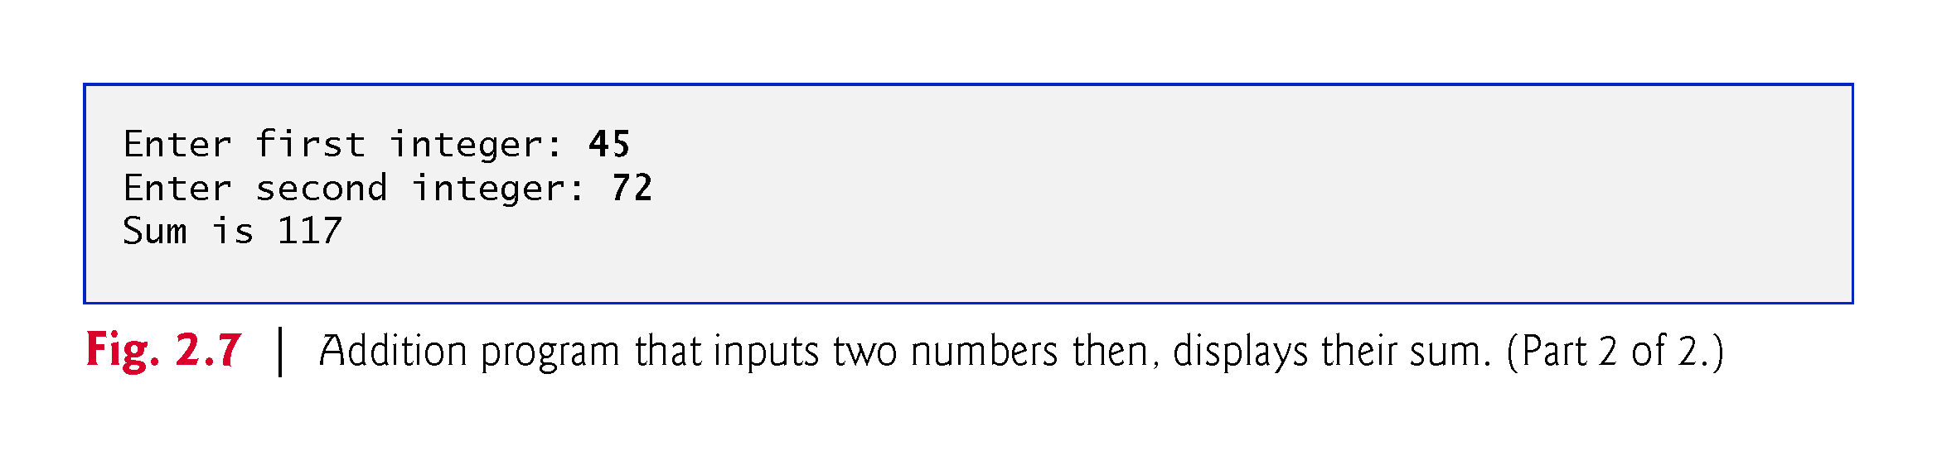

Slide 46
2.5 Another Application: Adding Integers (cont.)
import helps the compiler locate a class that is used in this program.
Rich set of predefined classes that you can reuse rather than “reinventing the wheel.”
Classes are grouped into packages—named groups of related classes—and are collectively referred to as the Java class library, or the Java Application Programming Interface (Java API).
You use import declarations to identify the predefined classes used in a Java program.

Slide 47
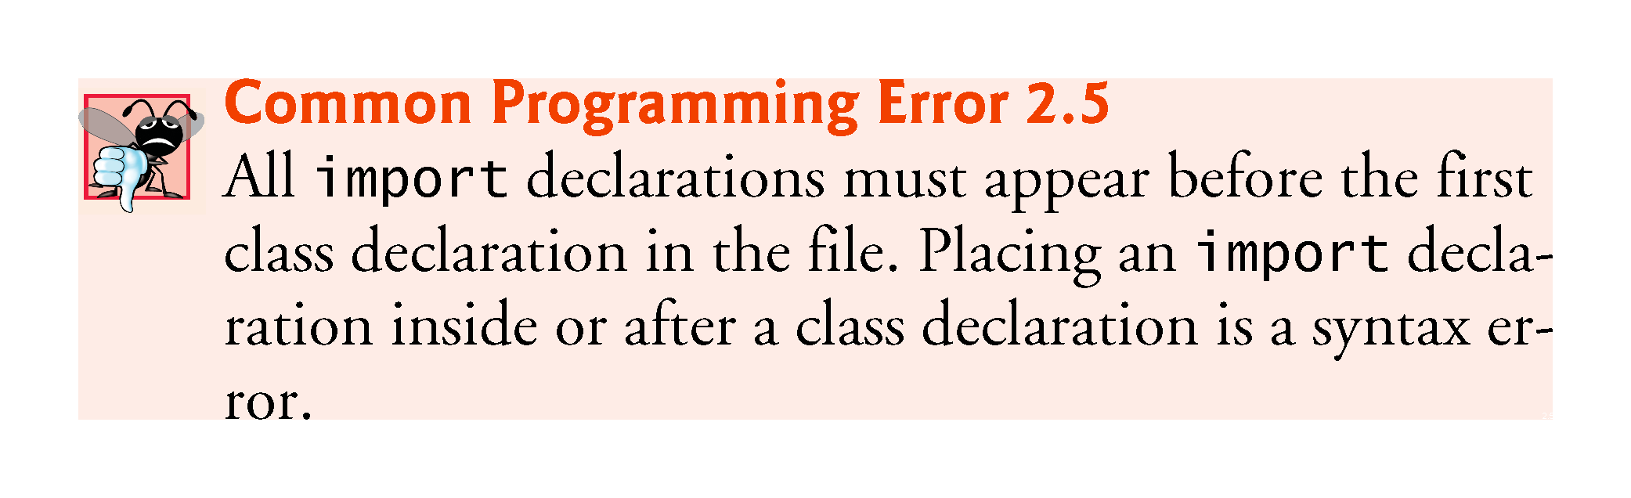

Slide 48
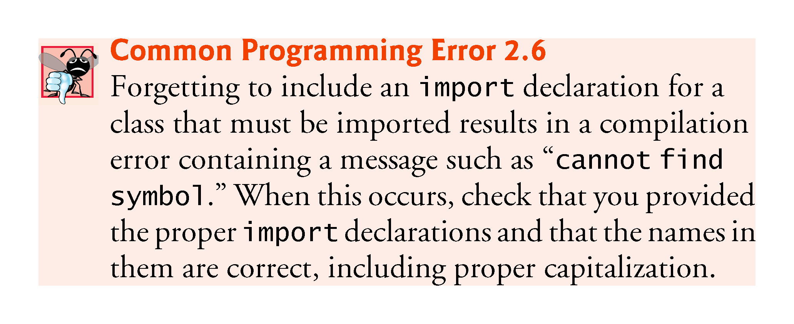

Slide 49
2.5 Another Application: Adding Integers (cont.)
Variable declaration statement
Scanner input = new Scanner(System.in);
Specifies the name (input) and type (Scanner) of a variable that is used in this program.
Variable
A location in the computer’s memory where a value can be stored for use later in a program.
Must be declared with a name and a type before they can be used.
A variable’s name enables the program to access the value of the variable in memory.
The name can be any valid identifier.
A variable’s type specifies what kind of information is stored at that location in memory.

Slide 50
2.5 Another Application: Adding Integers (cont.)
Scanner
Enables a program to read data for use in a program.
Data can come from many sources, such as the user at the keyboard or a file on disk.
Before using a Scanner, you must create it and specify the source of the data.
The equals sign (=) in a declaration indicates that the variable should be initialized (i.e., prepared for use in the program) with the result of the expression to the right of the equals sign.
The new keyword creates an object.
Standard input object, System.in, enables applications to read bytes of data typed by the user.
Scanner object translates these bytes into types that can be used in a program.

Slide 51
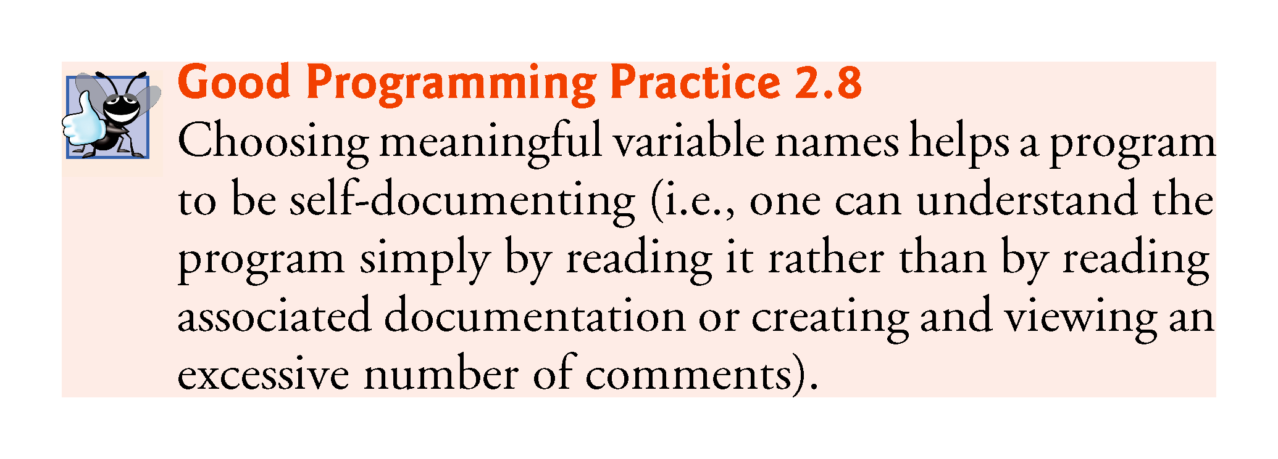

Slide 52
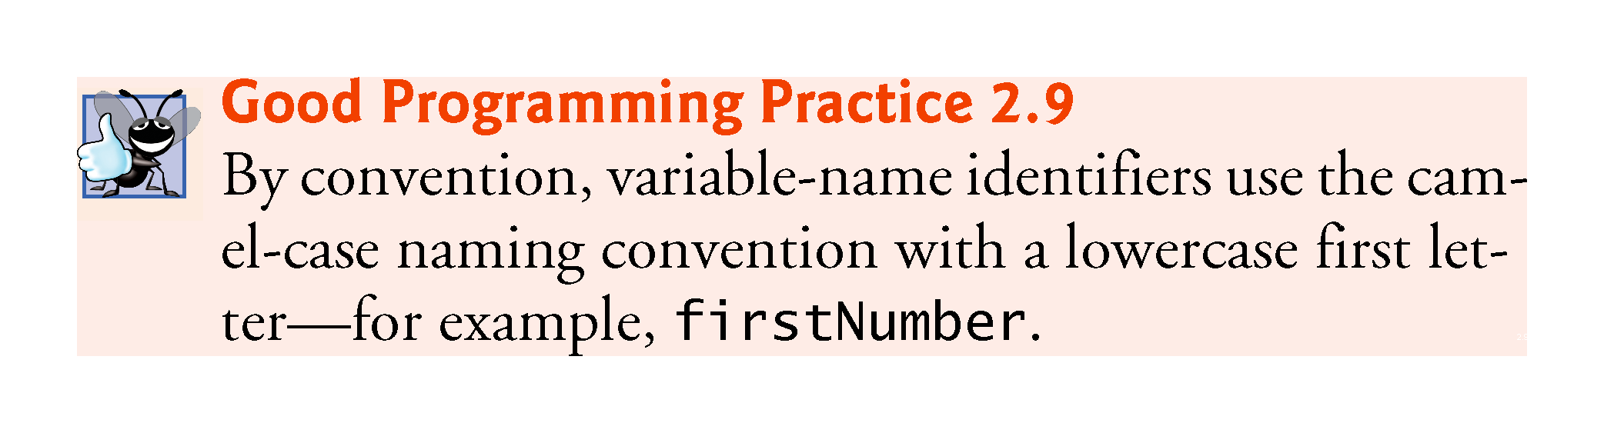

Slide 53
2.5.5 Prompting the User for Input
Prompt
Output statement that directs the user to take a specific action.
Class System
Part of package java.lang.
Class System is not imported with an import declaration at the beginning of the program.

Slide 54
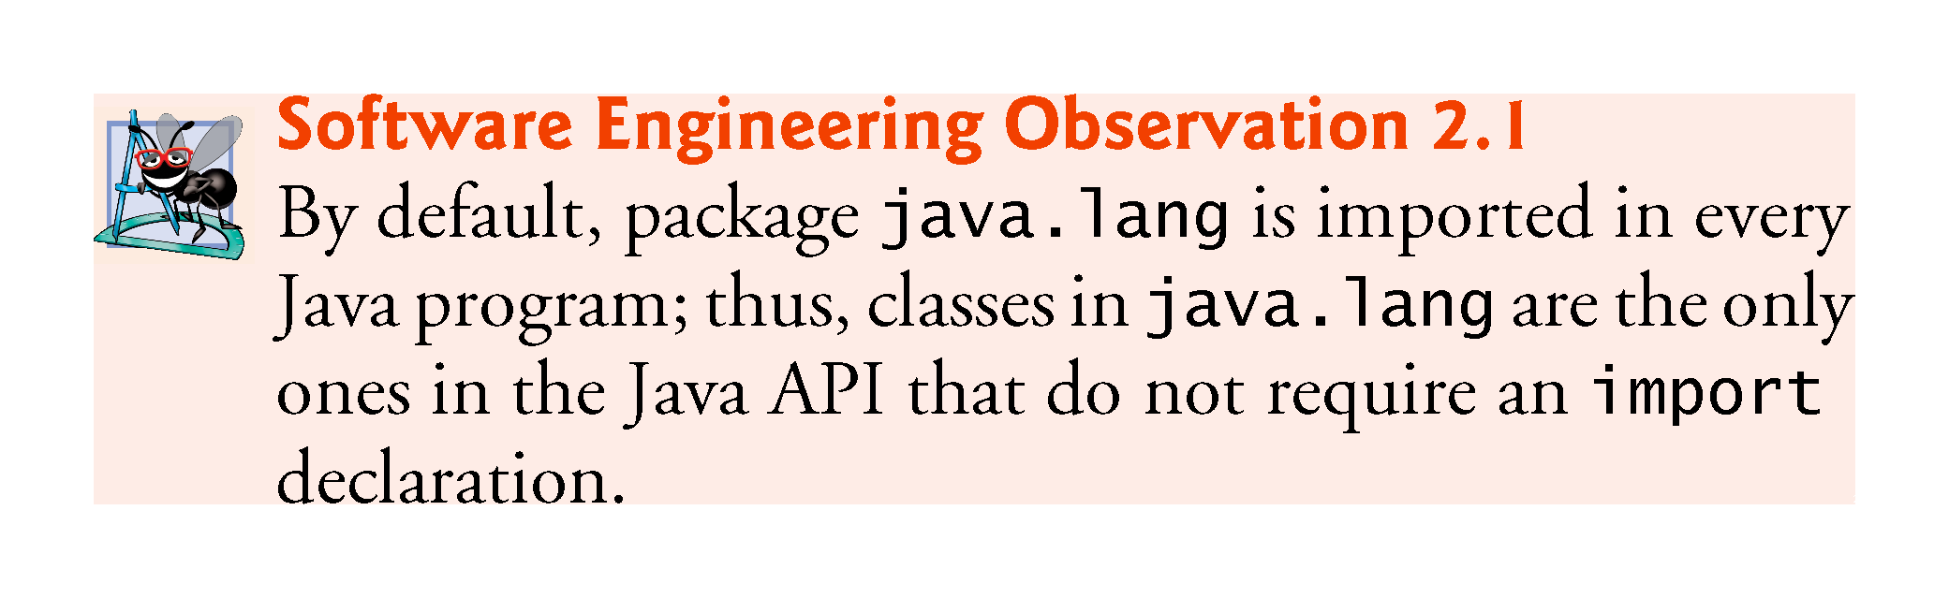

Slide 55
2.5 Another Application: Adding Integers (cont.)
Variable declaration statement
int number1 = input.nextInt(); // read first number from user
declares that variables number1 holds data of type int
Range of values for an int is –2,147,483,648 to +2,147,483,647.
The int values you use in a program may not contain commas.
For readability, you can place underscores in numbers
60_000_000 represents the int value 60,000,000

Slide 56
2.5 Another Application: Adding Integers (cont.)
Scanner method nextInt
Obtains an integer from the user at the keyboard.
Program waits for the user to type the number and press the Enter key to submit the number to the program.
The result of the call to method nextInt is placed in variable number1
The = indicates that int variable number1 should be initialized in its declaration with the result of input.nextInt()

Slide 57
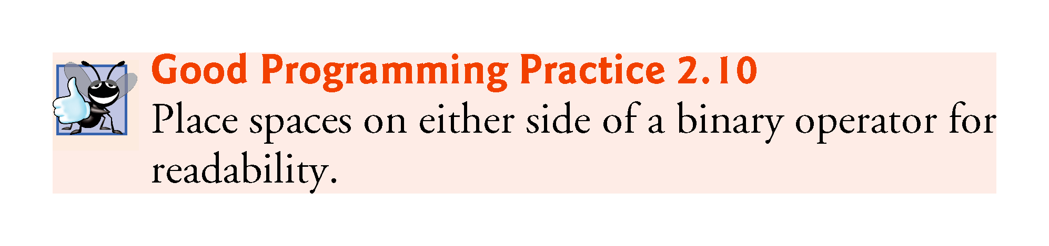

Slide 58
2.5 Another Application: Adding Integers (Cont.)
Arithmetic
int sum = number1 + number2; // add numbers then store total in sum
Calculates the sum of the variables number1 and number2 then assigns the result to variable sum.
Addition operator is a binary operator, because it has two operands—number1 and number2
Portions of statements that contain calculations are called expressions.
An expression is any portion of a statement that has a value associated with it.

Slide 59
2.5 Another Application: Adding Integers (Cont.)
Integer formatted output
System.out.printf("Sum is %d%n", sum);
Format specifier %d is a placeholder for an int value
The letter d stands for “decimal integer.”

Slide 60
2.6 Memory Concepts
Variables
Every variable has a name, a type, a size (in bytes) and a value.
When a new value is placed into a variable, the new value replaces the previous value (if any)
The previous value is lost, so this process is said to be destructive.

Slide 61
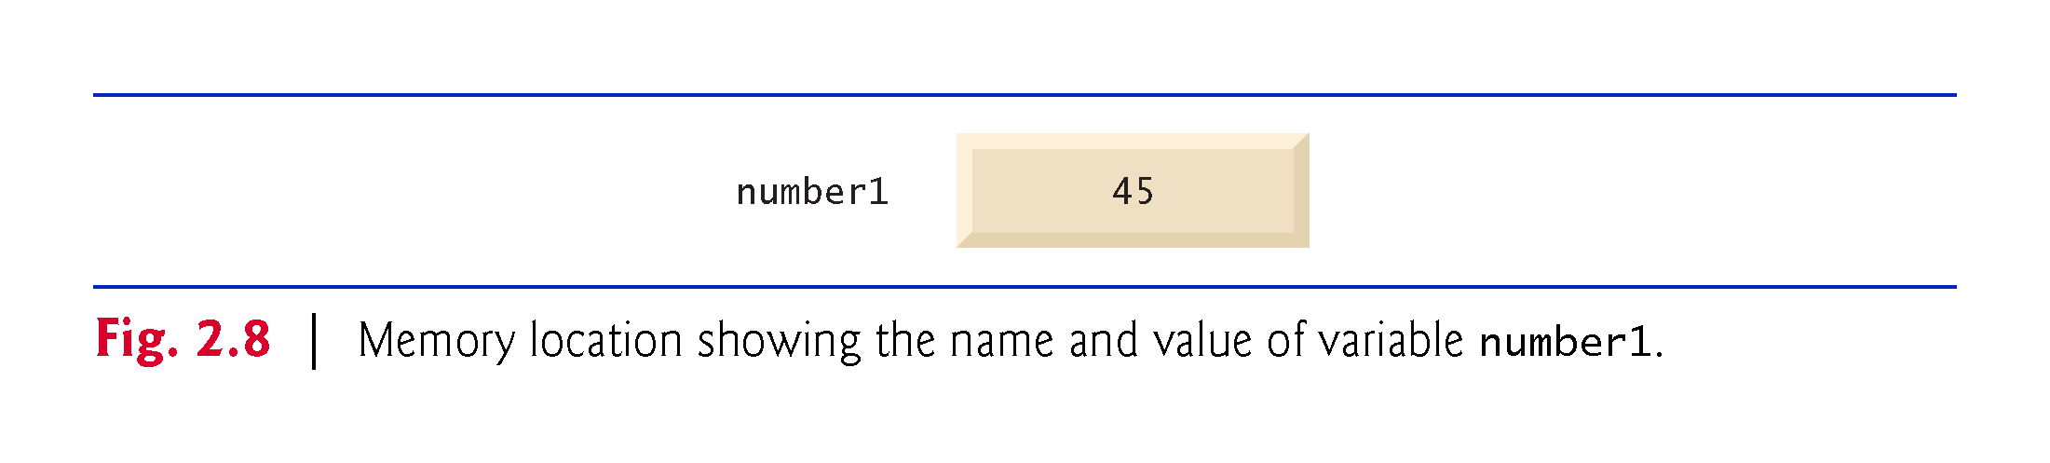

Slide 62
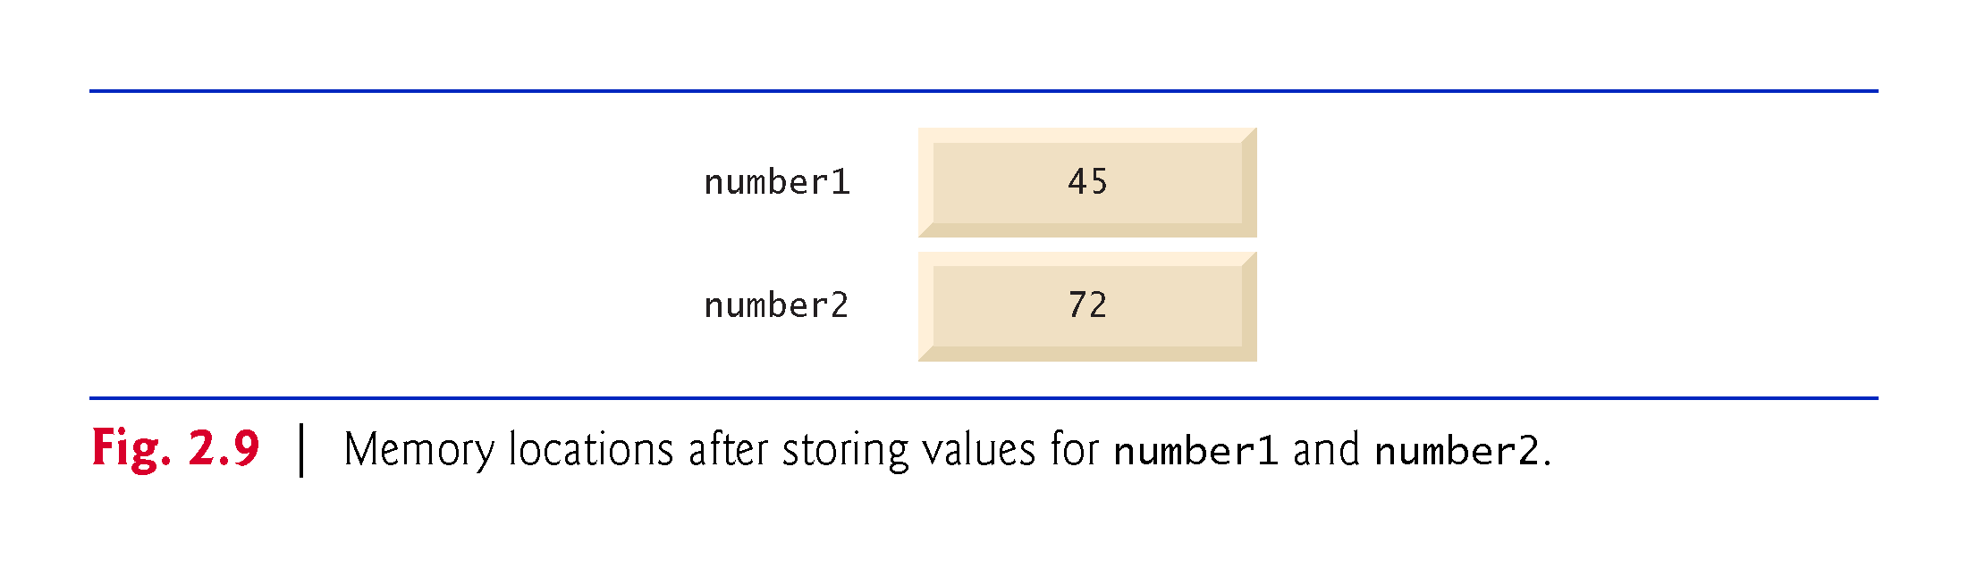

Slide 63
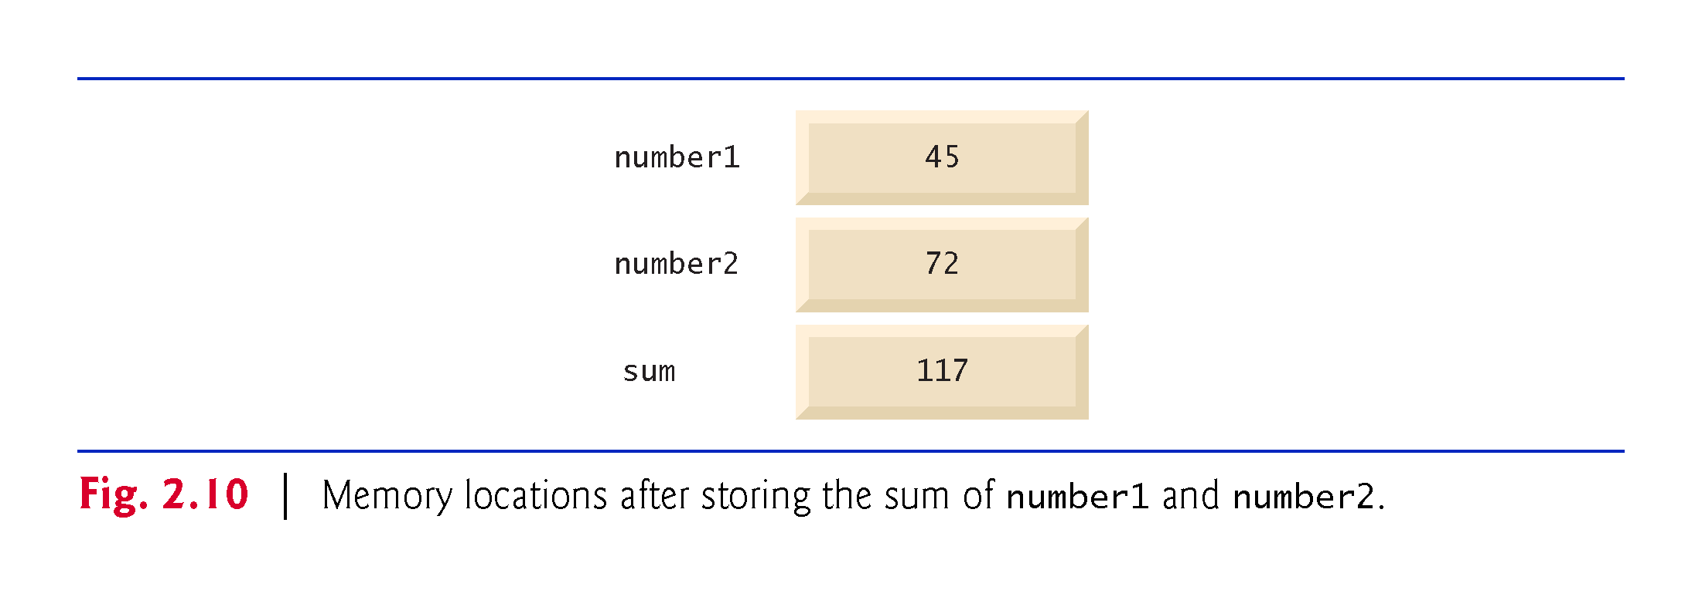

Slide 64
2.7 Arithmetic
Arithmetic operators are summarized in Fig. 2.11.
The asterisk (*) indicates multiplication
The percent sign (%) is the remainder operator
The arithmetic operators are binary operators because they each operate on two operands.
Integer division yields an integer quotient.
Any fractional part in integer division is simply truncated (i.e., discarded)—no rounding occurs.
The remainder operator, %, yields the remainder after division.

Slide 65
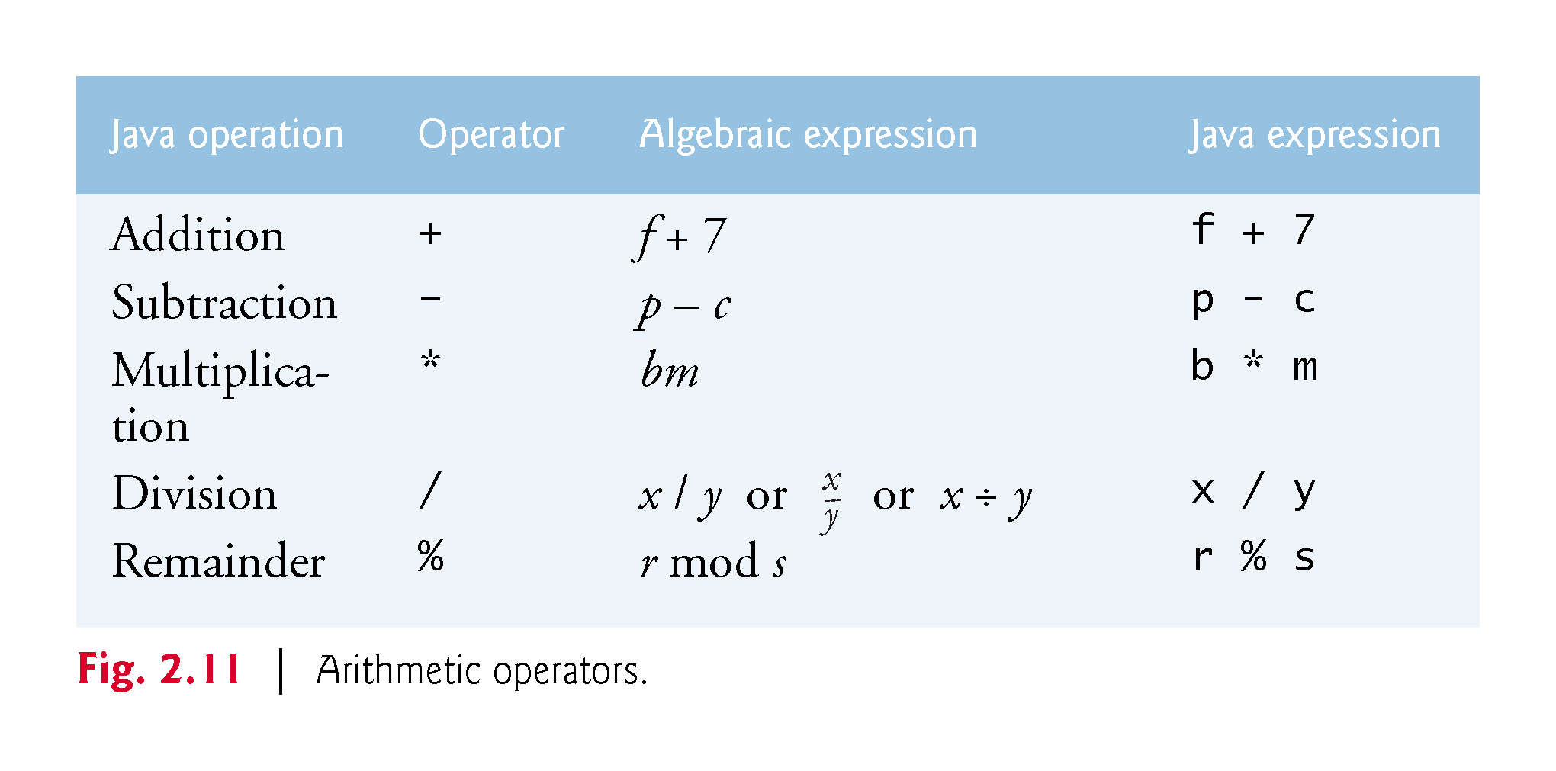

Slide 66
2.7 Arithmetic (Cont.)
Arithmetic expressions in Java must be written in straight-line form to facilitate entering programs into the computer.
Expressions such as “a divided by b” must be written as a / b, so that all constants, variables and operators appear in a straight line.
Parentheses are used to group terms in expressions in the same manner as in algebraic expressions.
If an expression contains nested parentheses, the expression in the innermost set of parentheses is evaluated first.

Slide 67
2.7 Arithmetic (Cont.)
Rules of operator precedence
Multiplication, division and remainder operations are applied first.
If an expression contains several such operations, they are applied from left to right.
Multiplication, division and remainder operators have the same level of precedence.
Addition and subtraction operations are applied next.
If an expression contains several such operations, the operators are applied from left to right.
Addition and subtraction operators have the same level of precedence.
When we say that operators are applied from left to right, we are referring to their associativity.
Some operators associate from right to left.
Complete precedence chart is included in Appendix A.

Slide 68
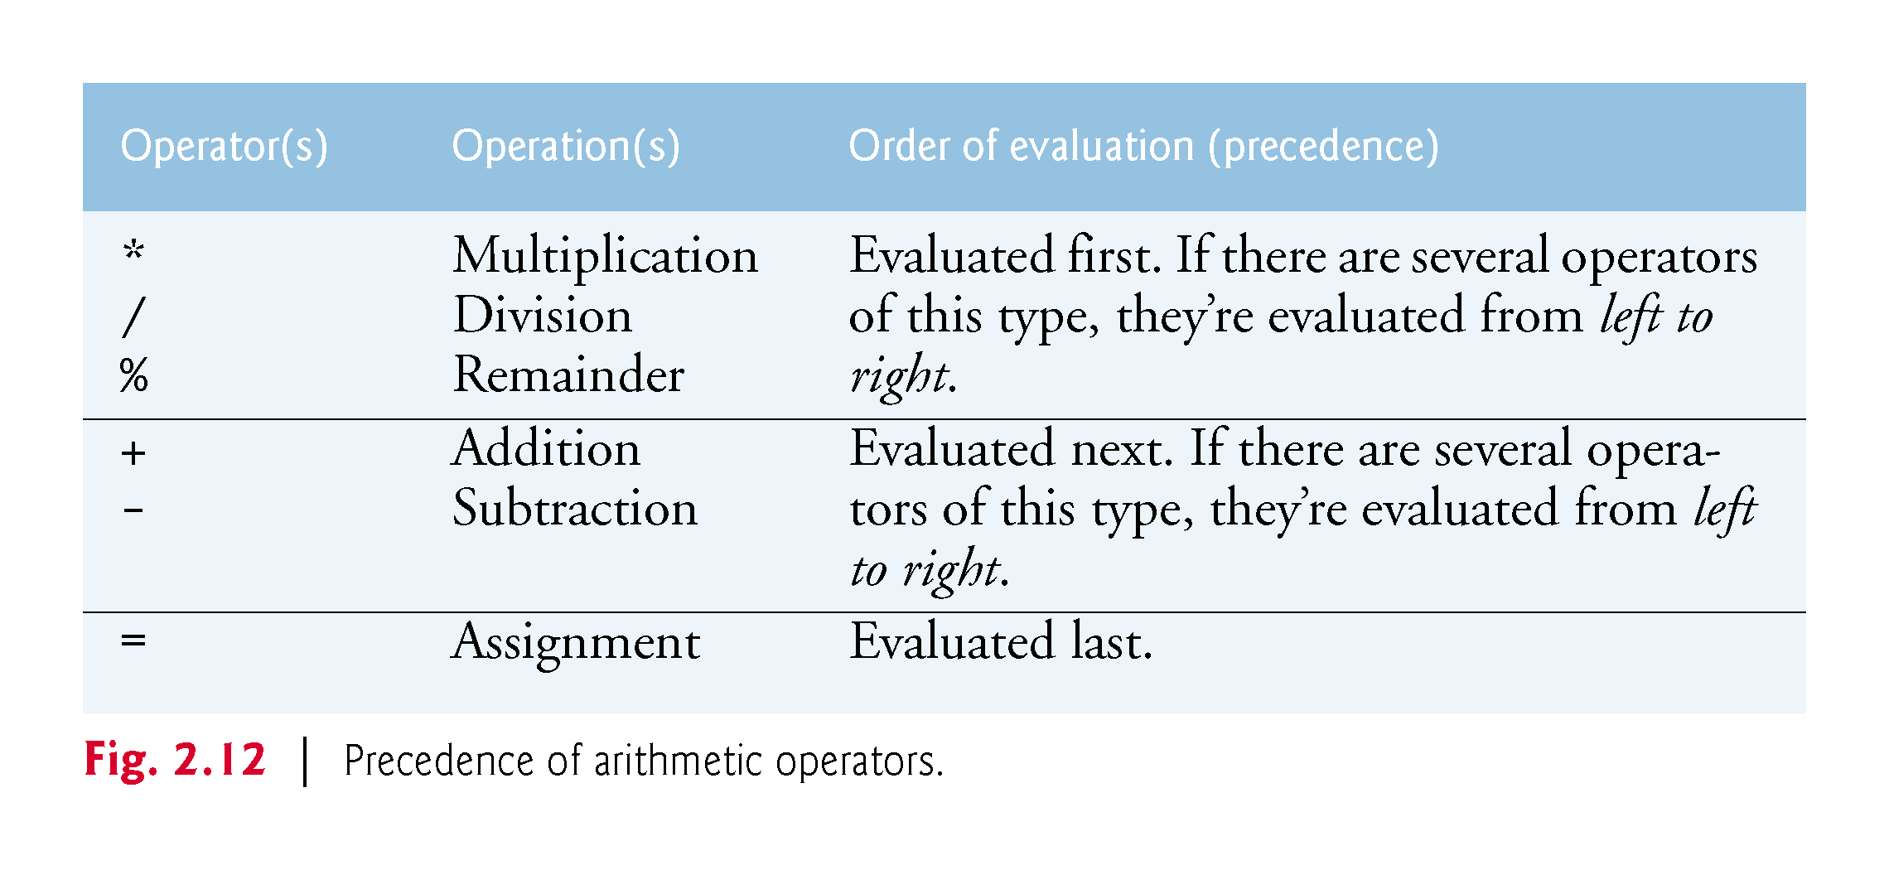

Slide 69
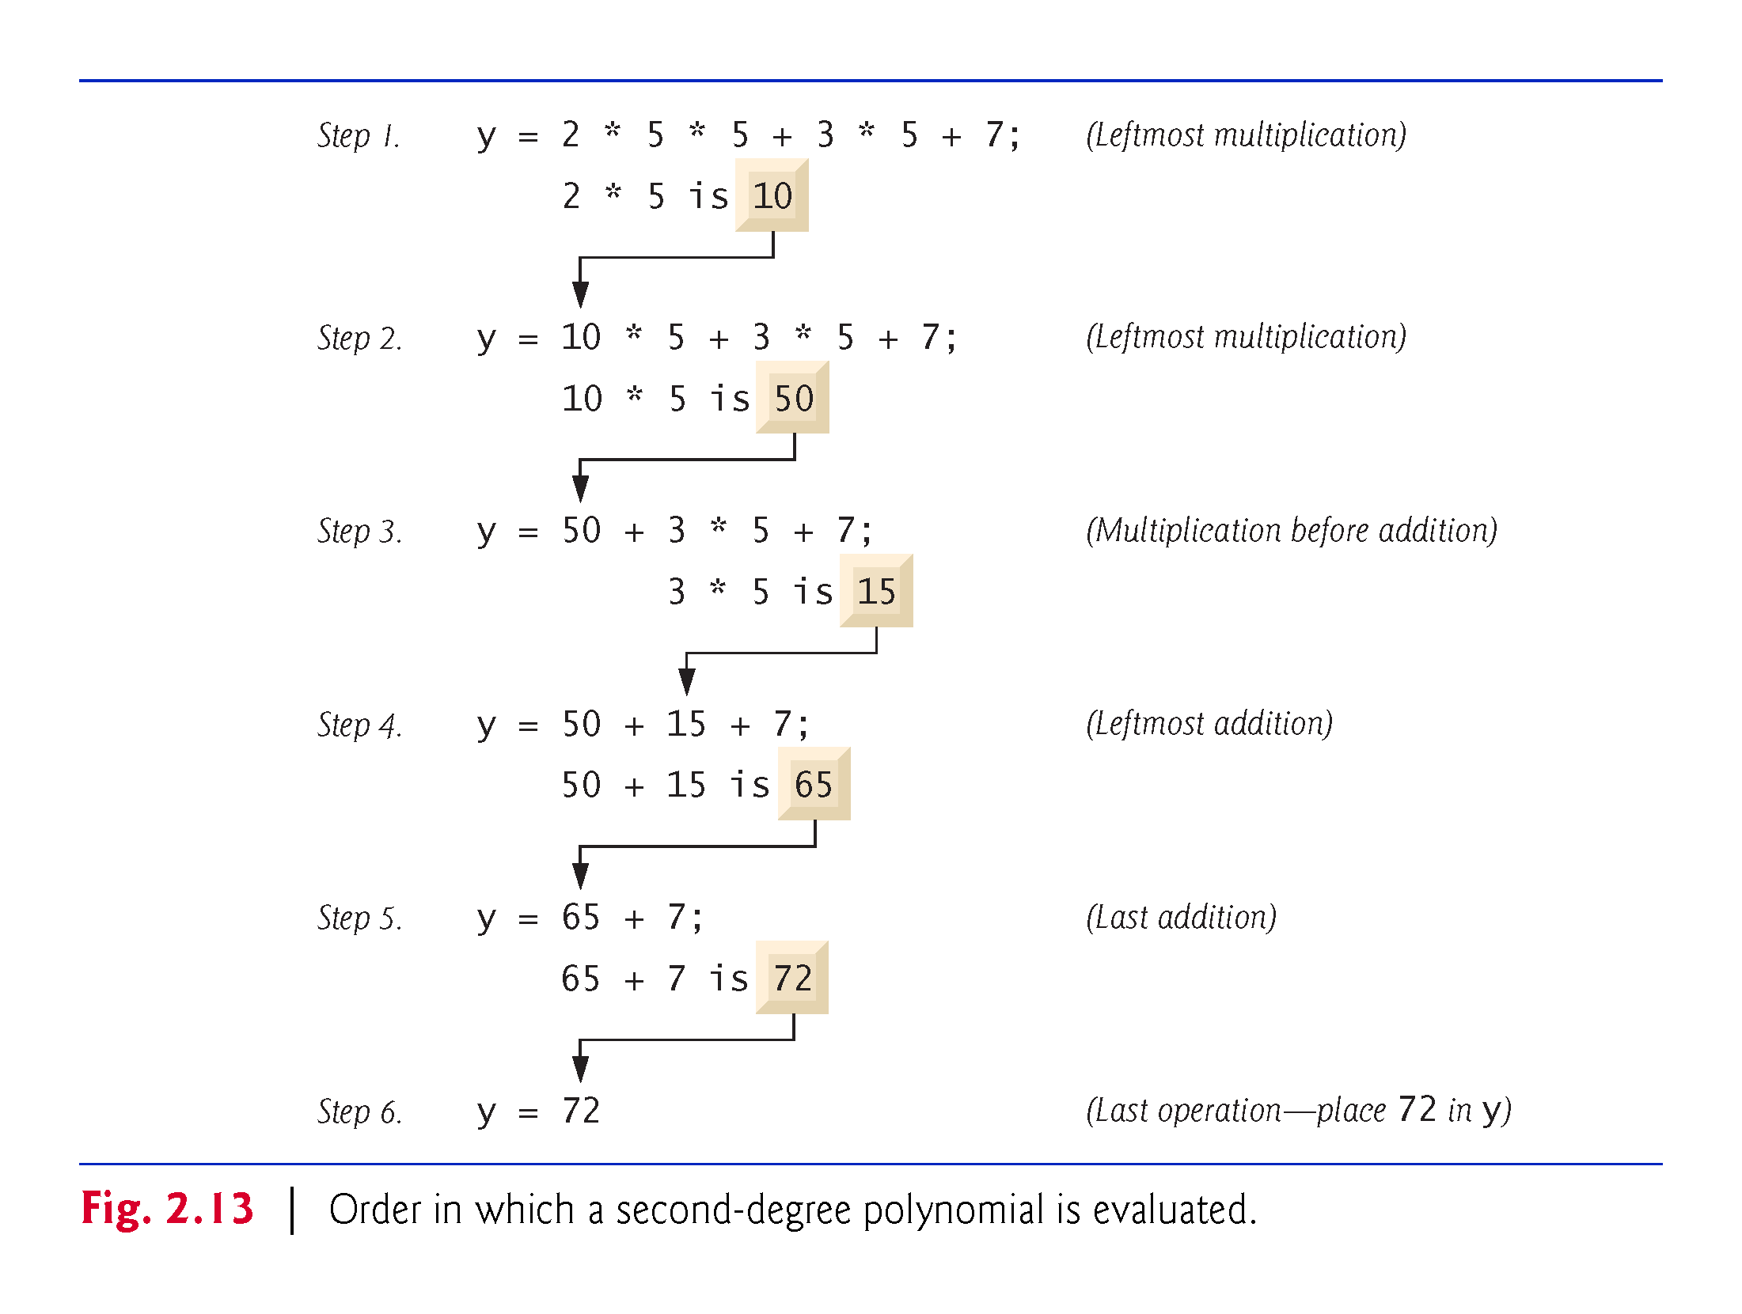

Slide 70
2.7 Arithmetic (Cont.)
As in algebra, it’s acceptable to place redundant parentheses (unnecessary parentheses) in an ex-pression to make the expression clearer.

Slide 71
2.8 Decision Making: Equality and Relational Operators
Condition
An expression that can be true or false.
if selection statement
Allows a program to make a decision based on a condition’s value.
Equality operators (== and !=)
Relational operators (>, <, >= and <=)
Both equality operators have the same level of precedence, which is lower than that of the relational operators.
The equality operators associate from left to right.
The relational operators all have the same level of precedence and also associate from left to right.

Slide 72
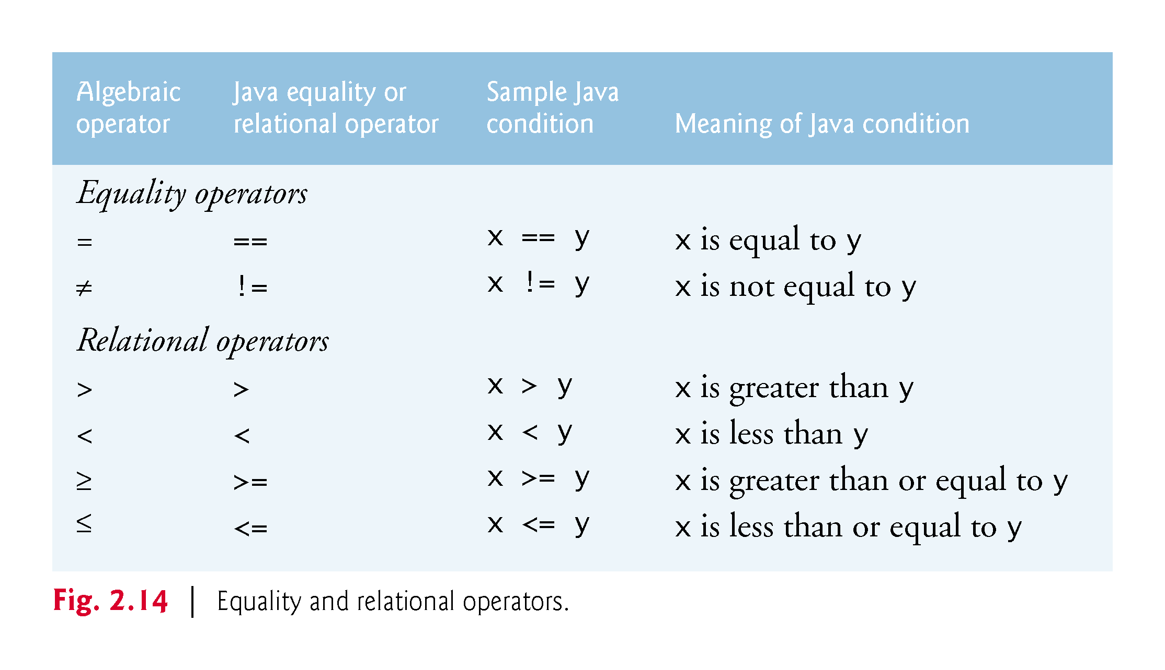

Slide 73
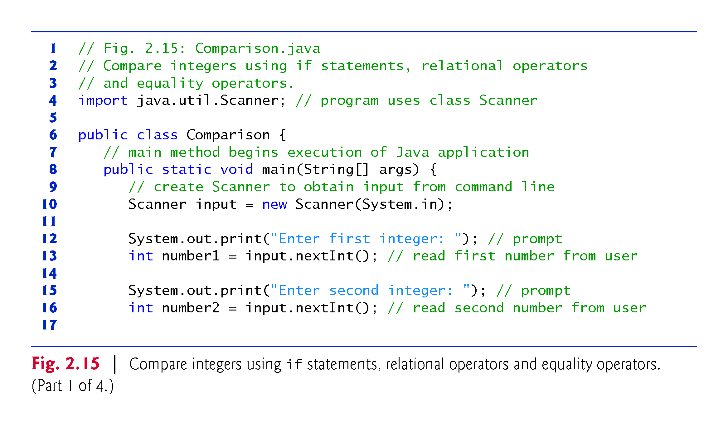

Slide 74
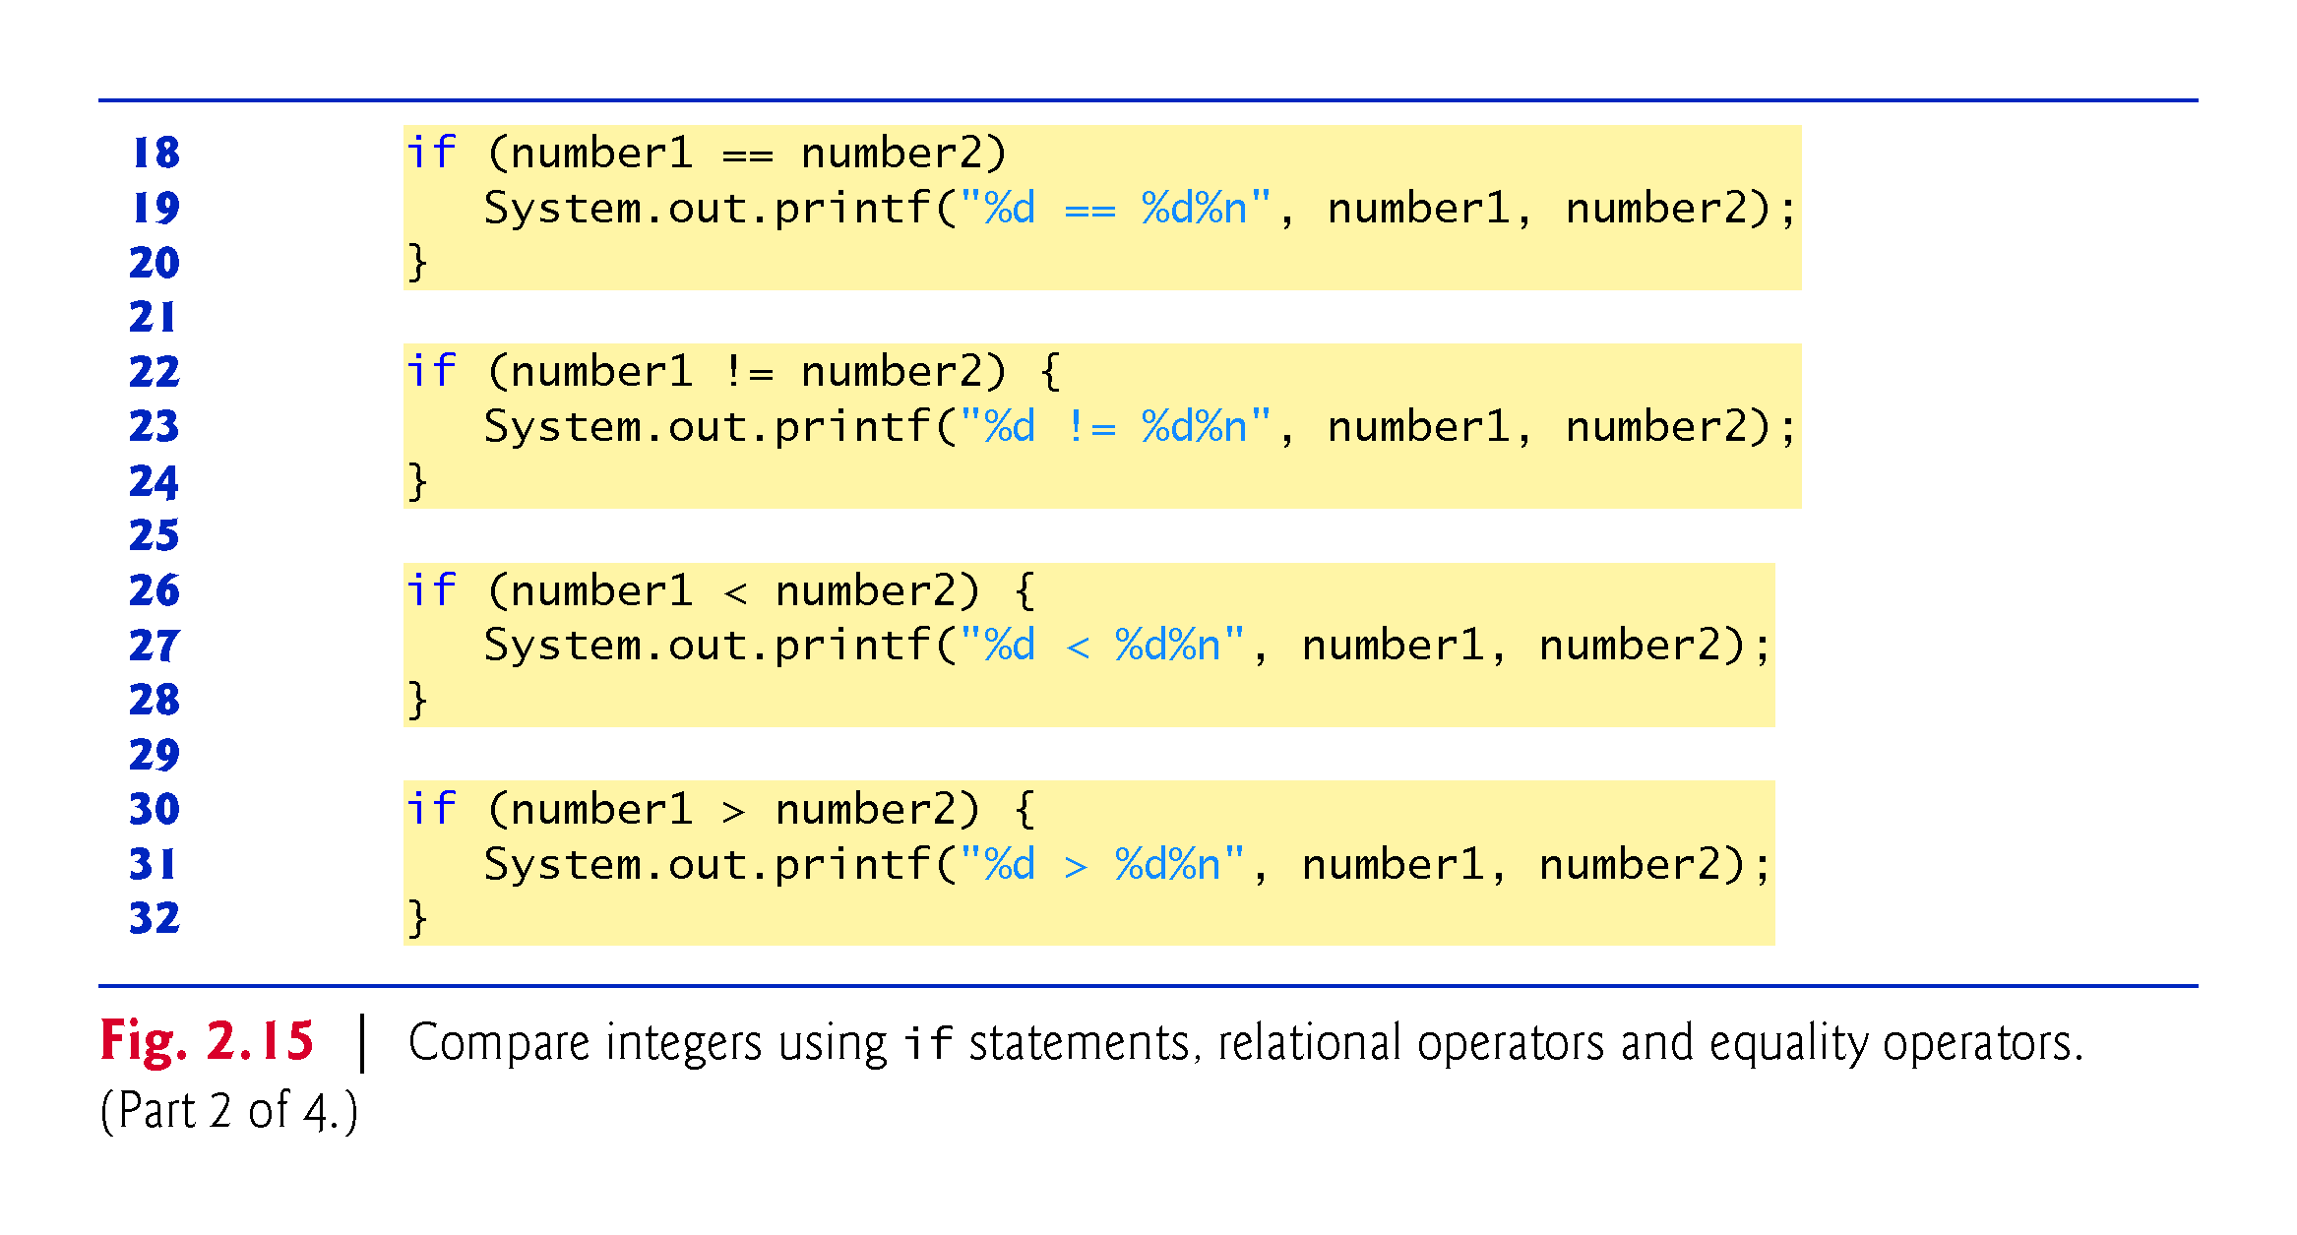

Slide 75
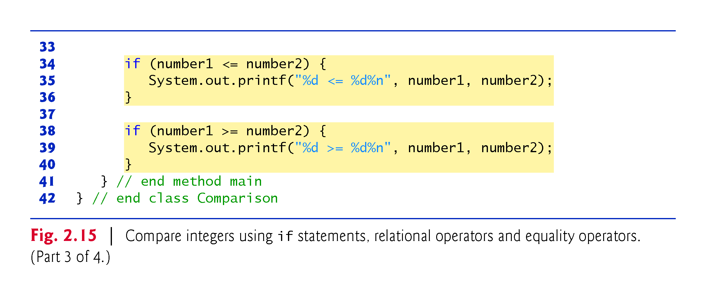

Slide 76
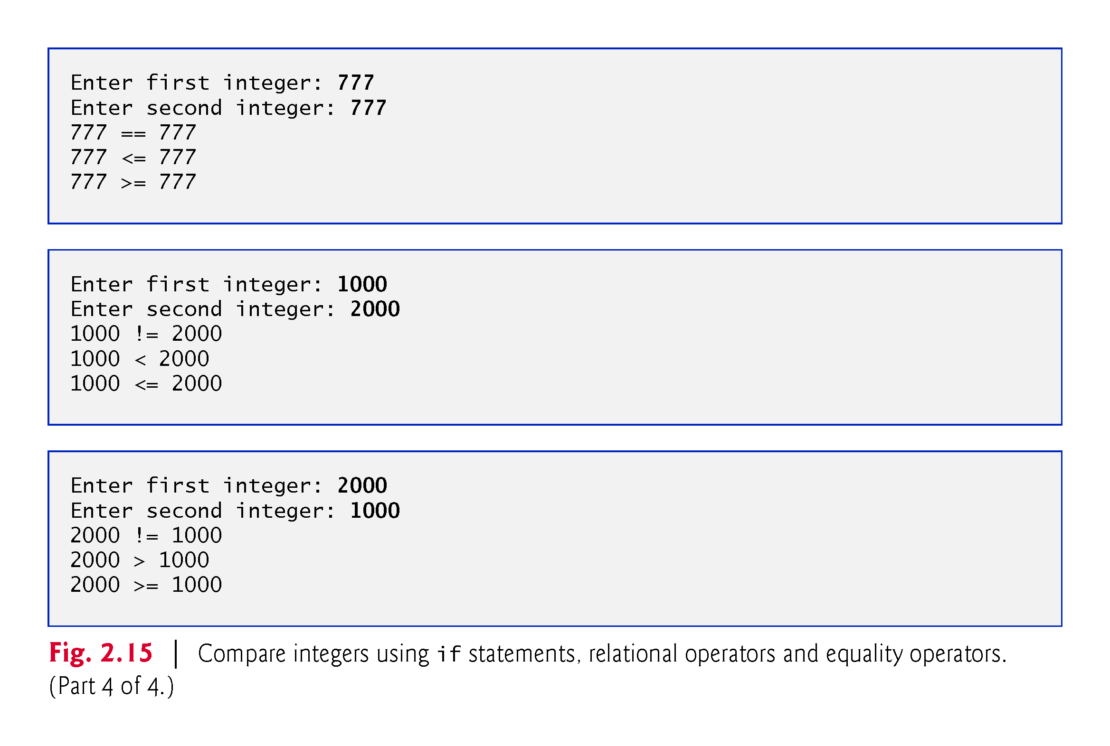

Slide 77
2.8 Decision Making: Equality and Relational Operators (Cont.)
An if statement always begins with keyword if, followed by a condition in parentheses.
We’ve enclosed each body statement in a pair of braces, { }, creating what’s called a compound statement or a block
The indentation of the body statement is not required, but it improves the program’s readability by emphasizing that statements are part of the body

Slide 78
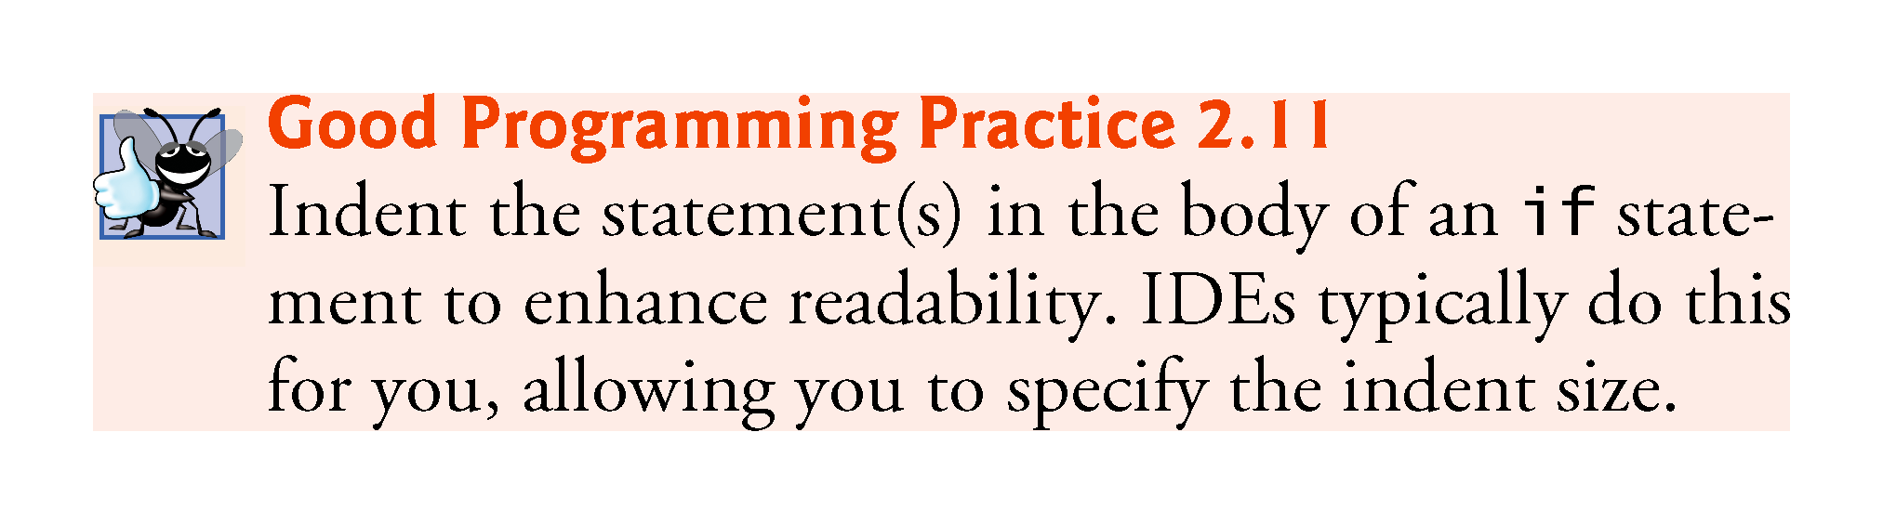

Slide 79
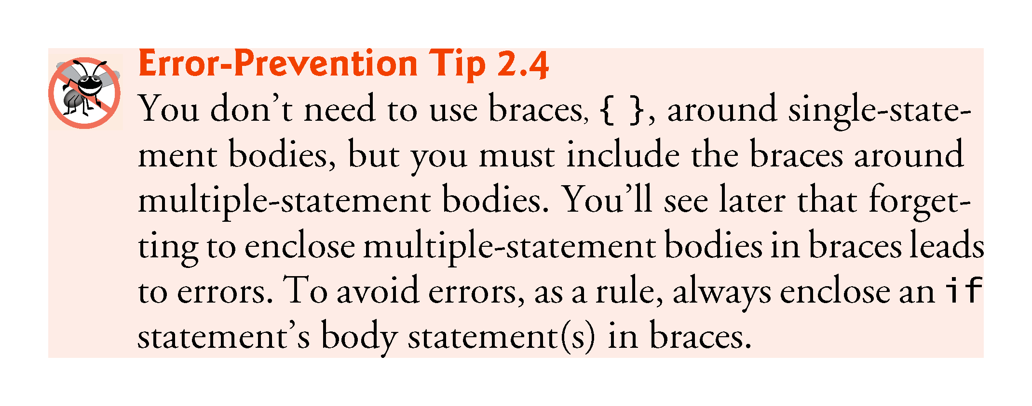

Slide 80
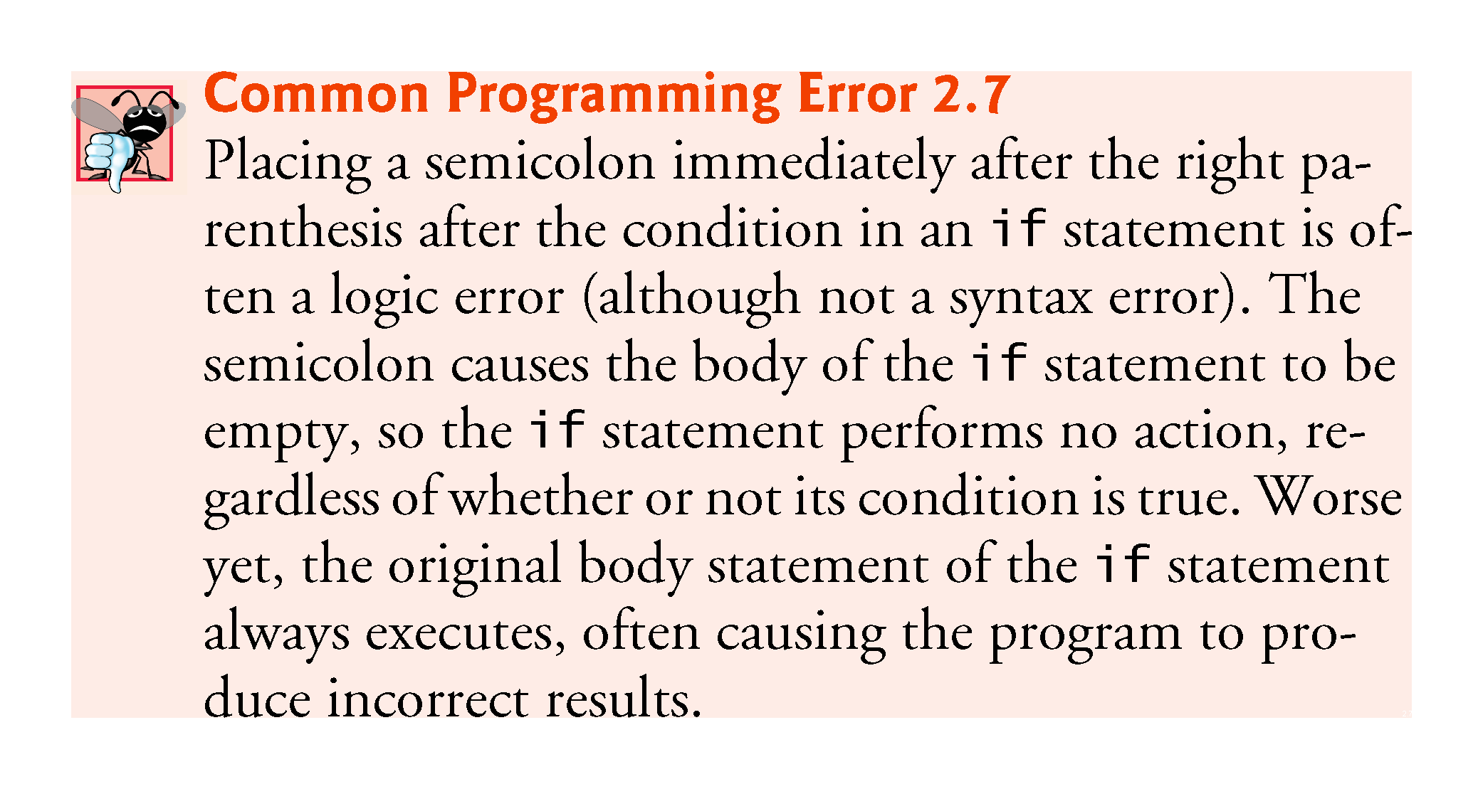

Slide 81
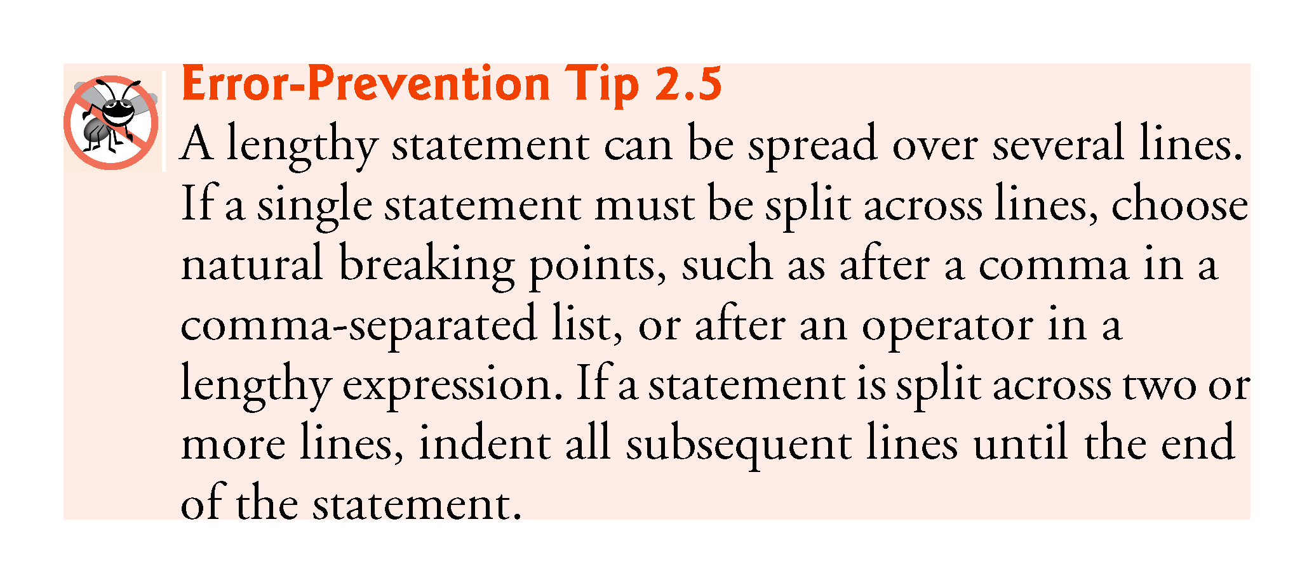

Slide 82
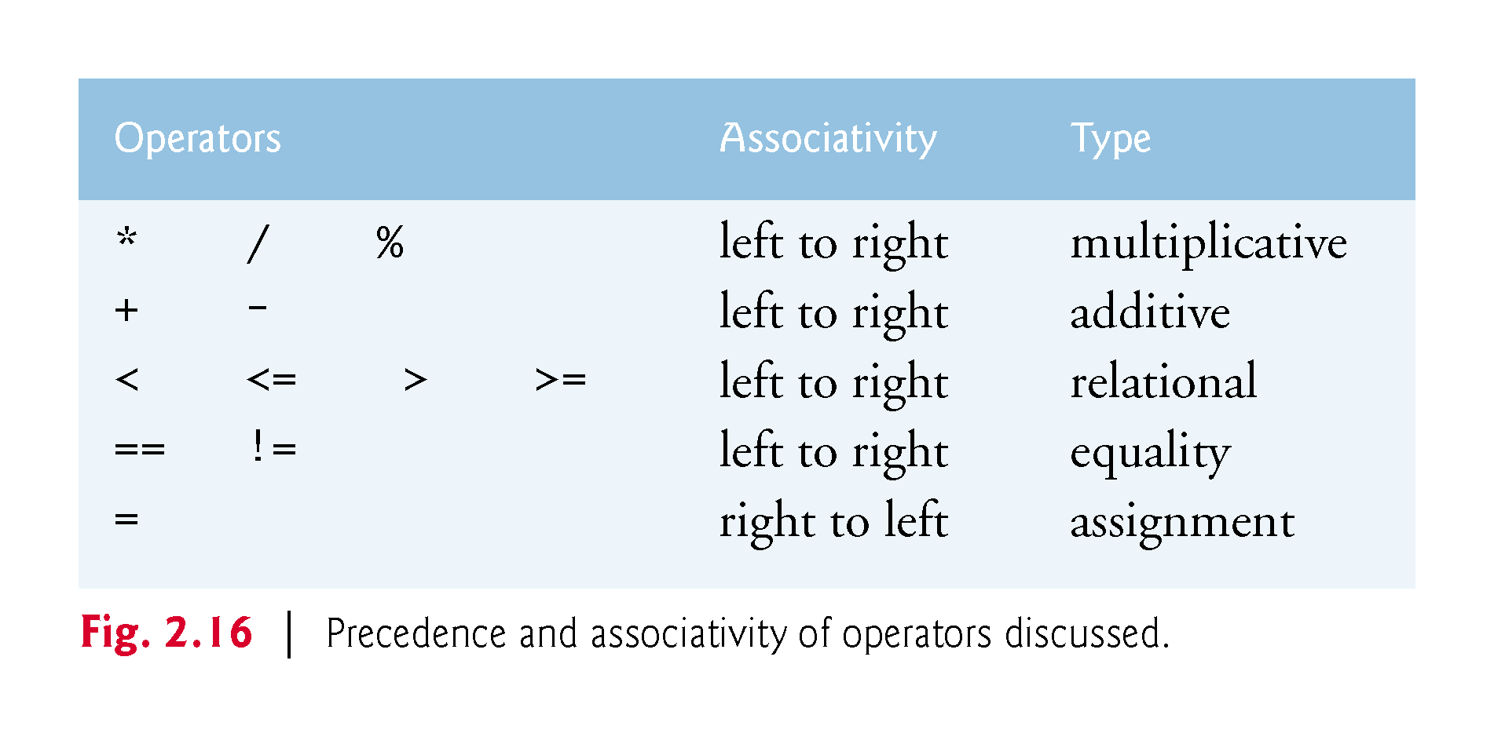

Slide 83
